Slide 1
Using Art Therapy with Patients with EDs – Jonathan McFarland, Cristina Gonzalez, Mª Luisa Cuesta Santamaria, Isabel Maria Martin Ruiz, Eugenia Nadolu Velez, Eva Garcia Perea
Connected 4 Health

Slide 2
Humanistic ( Arts ) Therapies
What is Arts Therapy
“Arts therapy is an umbrella term for a diverse assortment of sub-specialty experiential therapies that cross a wide variety of artistic disciplines. Based on the literature, three major sub-specialties of arts-based therapies emerged in the treatment of eating disorders: music therapy (MT), dance/movement therapy (DMT), and creative-arts therapy (CAT).”

Slide 3
PLASTIC ARTS
The arts, like all non-verbal expressions, encourages the exploration, expression and communication of aspects of which we are not aware (Duncan, 2006, p.40).
“Children like to explore, touch, manipulate, turn objects around a thousand times, they like to create… it is their way of exploring the world, of getting to know it”
With accompaniment and guidance you can approach this emotion

Slide 4
‘All children are artists. The problem is how to remain an artist once he grows up.’ *
(Son Espases University Hospital paediatric-juvenile Psychiatric ward)
* Picasso

Slide 5
Finger Painting for patients with EDs
Finger painting is about movement and through movement there is freedom of expression
A way to establish a relationship and connection with yourself and others by exploring feelings without words or language
To restore or reconnect to that inner “you”
If you connect with your inner “you” then you can connect with your peers
Bonding with yourself leads to bonding with others
Then little by little you begin to express your emotions verbally

Slide 6
MUSIC THERAPY
“Music therapy, as defined by the World Federation of Music Therapy (WFMT, 2011 update), is the professional use of music and its elements as an intervention in medical, educational and everyday settings with individuals, groups, families or communities seeking to optimize their quality of life and improve their physical, social, communicative, emotional, intellectual and spiritual health and well-being. Research, practice, education and clinical training in music therapy are based on professional standards according to cultural, social and political contexts”

Slide 7
Music helps
1. to alleviate depression and anxiety (commonly associated with” – Obesity + the stigma associated
2. to relax, to improve sleep and rest, to improve and create a proper identity and self-esteem.
It seeks to give voice to the healthy inner voice that wants to heal, to reduce stress and pressure levels.
Music therapy sessions are perceived as a playful and relaxed environment that helps to reduce the sense of ridicule, working from humor and from the creation of a good therapeutic bond, with the professional music therapist and / or the group.

Slide 8
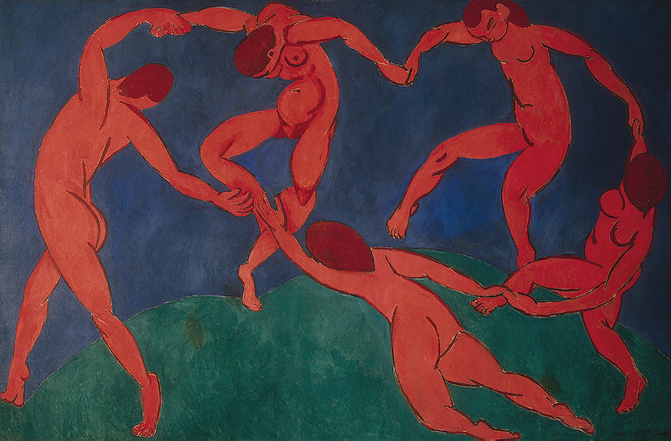
Dance Therapy
Henri Matisse, La danse 1909, (Wikipedia)

Slide 9
Dance Therapy
Dance/movement therapy, usually referred to simply as dance therapy or DMT, is a type of therapy that uses movement to help individuals achieve emotional, cognitive, physical, and social integration. Beneficial for both physical and mental health, dance therapy can be used for stress reduction, disease prevention, and mood management.
Dance therapists work with people in therapy to help them improve their body image and self esteem
https://www.goodtherapy.org/learn-about-therapy/types/dance-movement-therapy

Slide 10
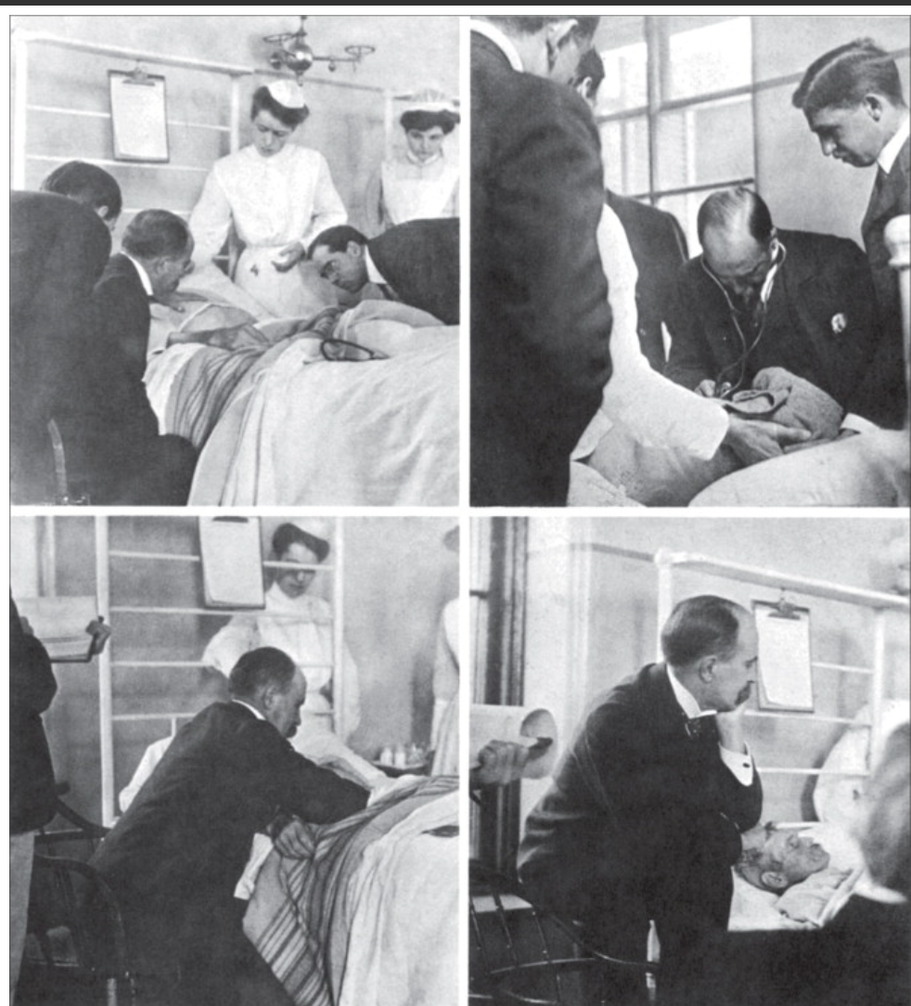
Take Home Message
Never forget……..
To listen to the ‘person’ in the patient
FigureSir William Osler at the bedside of a patient
Copyright © 2014 NYPL/Science Source/Science Photo Library

Slide 11
References
Frank A. Futility and Avoidance: Medical Professionals in the Treatment of Obesity. JAMA. 1993;269(16):2132–2133. doi:10.1001/jama.1993.03500160102
https://www.who.int/health-topics/obesity#tab=tab_2
La Arteterapia como terapia para pacientes con trastornos de la conducta alimentaria
in Anorexia y Bulimia, Profesionales TCA, Recursos TCA, Testimonios
6, octubre, 2016
Frisch MJ, Franko DL, Herzog DB. Arts-based therapies in the treatment of eating disorders. Eat Disord. 2006 Mar-Apr;14(2):131-42. doi: 10.1080/10640260500403857. PMID: 16777810.
https://www.goodtherapy.org/learn-about-therapy/types/dance-movement-therapy
chrome-extension://nlaealbpbmpioeidemdfedkfmglobidl/https://connected4health.pixel-online.org/files/results/EN_Handbook.pdf

