Slide 1
Communicating with Patients with Obesity – The Humanistic Approach Jonathan McFarland, Cristina Gonzalez, Mª Luisa Cuesta Santamaria, Isabel Maria Martin Ruiz, Eugenia Nadolu Velez, Eva Garcia Perea
Connected 4 Health

Slide 2
Project Number: 2021-1-RO01- KA220-HED-38B739A3
The European Commission's support for the production of this presentation does not constitute an endorsement of the contents, which reflect the views only of the authors, and the Commission cannot be held responsible for any use which may be made of the information contained therein.

Slide 3
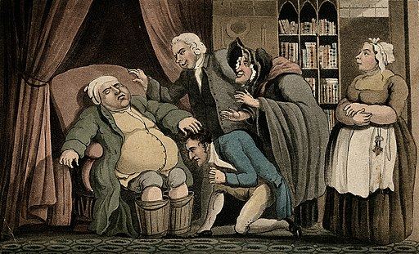
Obesity
An obese gouty man with his feet in buckets
Copyrighted work available under Creative Commons Attribution only licence CC BY 4.0 http://creativecommons.org/licenses/by/4.0/

Slide 4
Obesity: Definition
Overweight and obesity are defined as abnormal or excessive fat accumulation that presents a risk to health. A body mass index (BMI) over 25 is considered overweight, and over 30 is obese. The issue has grown to epidemic proportions, with over 4 million people dying each year as a result of being overweight or obese in 2017 according to the global burden of disease.
Rates of overweight and obesity continue to grow in adults and children. From 1975 to 2016, the prevalence of overweight or obese children and adolescents aged 5–19 years increased more than four-fold from 4% to 18% globally.

Slide 5
Obesity: Complications
Overweight and obesity are major risk factors for a number of chronic diseases, including cardiovascular diseases such as heart disease and stroke, which are the leading causes of death worldwide.
Obesity is also associated with some cancers, including endometrial, breast, ovarian, prostate, liver, gallbladder, kidney and colon. The risk of these noncommunicable diseases increases even when a person is only slightly overweight and grows more serious as the body mass index (BMI) climbs.

Slide 6
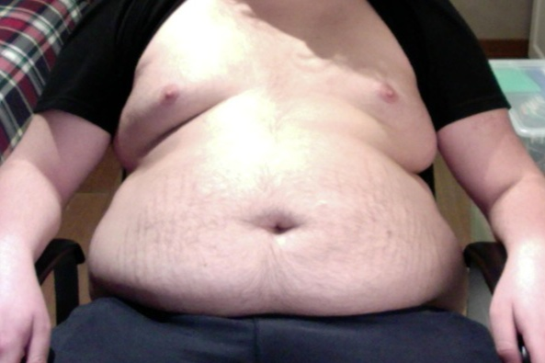
Anti-fat attitudes
Obese teenage boy, 136 kg 300 lbs
This file is licensed under the Creative Commons Attribution-Share Alike 4.0 International license.

Slide 7
Anti-fat defintion
Anti-fat prejudice, also referred to in the literature as weight stigma, weight bias and anti-fat attitudes, is a negative attitude toward (dislike of), belief about (stereotype), or behavior against (discrimination) people perceived as being ‘fat’.

Slide 8
What is stigma ?
A set of negative and often unfair beliefs that a society or group of people have about something.
The stigma associated with mental illness = the stigma of mental illness
The stigma of being poor = the stigma of poverty
There's a social stigma attached to receiving welfare.

Slide 9
Erving Goffman, an American sociologist
Presented the fundamentals of stigma as a social theory, including his interpretation of “stigma” as a means of spoiling identity. By this, he referred to the stigmatized trait’s ability to “spoil” recognition of the individual’s adherence to social norms in other facets of self
Goffman identified three main types of stigma: (1) stigma associated with mental illness; (2) stigma associated with physical deformation; and (3) stigma attached to identification with a particular race, ethnicity, religion, ideology, etc.

Slide 10
2. ‘Stigma associated with physical deformation’ (Goffman)
Weight stigma refers to the discriminatory acts and ideologies targeted towards individuals because of their weight and size.
Weight stigma is a result of weight bias.
Weight bias refers to the negative ideologies associated with obesity.

Slide 11
These can include laziness, lack of will power, a lack of moral character, bad hygiene, low level of intelligence and unattractiveness. Stigmatising beliefs and ideologies can lead to stigmatising acts. These acts can manifest themselves in various different ways
People with obesity may experience negative verbal commentaries, teasing, or physical assault.
The environment also plays a part -
This is commonly reported in medical settings in particular, where seating, gowns and examination tables are unable to accommodate people with obesity.

Slide 12
Weight bias ( stigmatization in Heathcare)
Weight bias persists into healthcare settings.
The use of stereotypical characteristics such as lazy, weak- willed, and noncompliant is rife.
Physicians generally have lower levels of respect for patients with higher BMI and generally spend less time providing consultations to patients with obesity compared to their healthy-weight counterparts. In one study by Puhl and Brownell, 53% of people with overweight and obesity reported to have received inappropriate comments from their doctor about their weight.

Slide 13
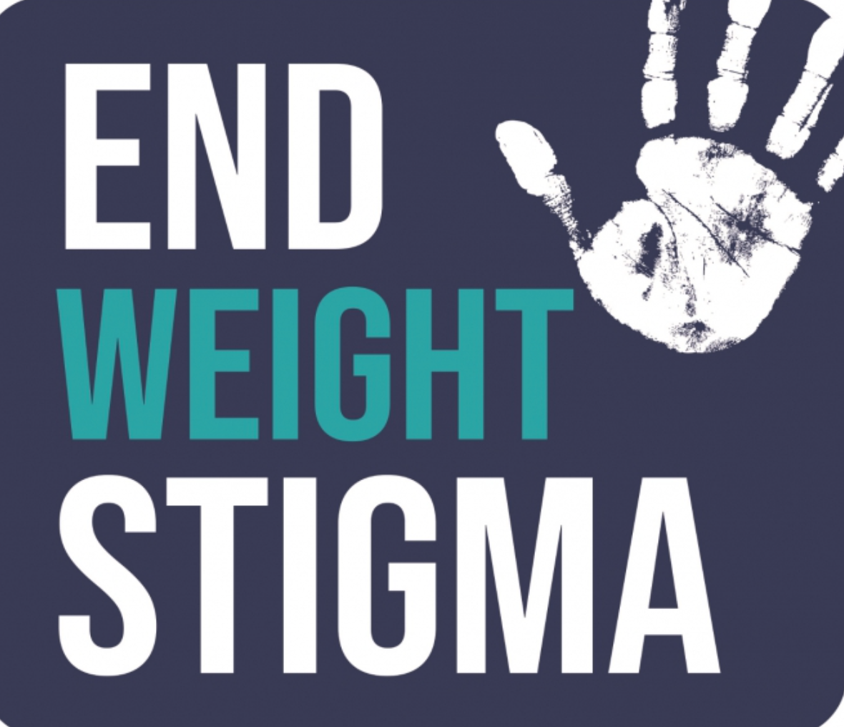
Ways to combat weight stigma

Slide 14
People-first language
Obesity is one of the last diseases where society has failed to implement people first language. People-first language puts the person before their disease, emphasising that an individual is not defined by their condition.
For example, it is now very uncommon to see someone referred to as a disabled person; you'll more likely see reference to a person with a disability. The person comes first, and their disability is a characteristic rather than a defining feature.
Unfortunately, this is not yet the norm with obesity

Slide 15
People-first language involves putting the person before the condition. The Obesity Action Coalition provides a couple of examples:
“The woman was affected by obesity.” instead of “The woman was obese.”
“The man with obesity was on the bus.” instead of “The man on the bus was very obese.”

Slide 17
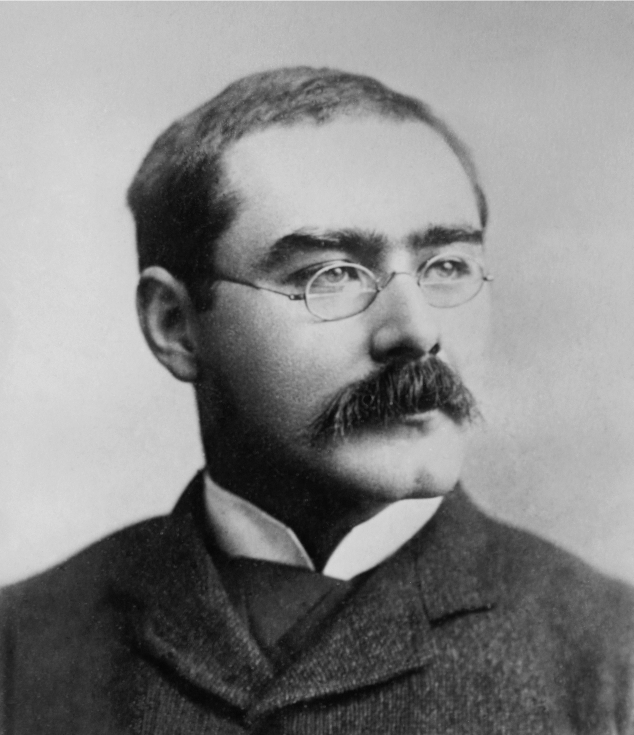
The Importance of words
“I am, by calling, a dealer in words; and words are, of course, the most powerful drug used by mankind. Not only do words infect, egotize, narcotize, and paralyze, but they enter into and colour the minutest cells of the brain ….”
Rudyard Kipling. (2023, January 29). In Wikipedia. https://en.wikipedia.org/wiki/Rudyard_Kipling

Slide 19
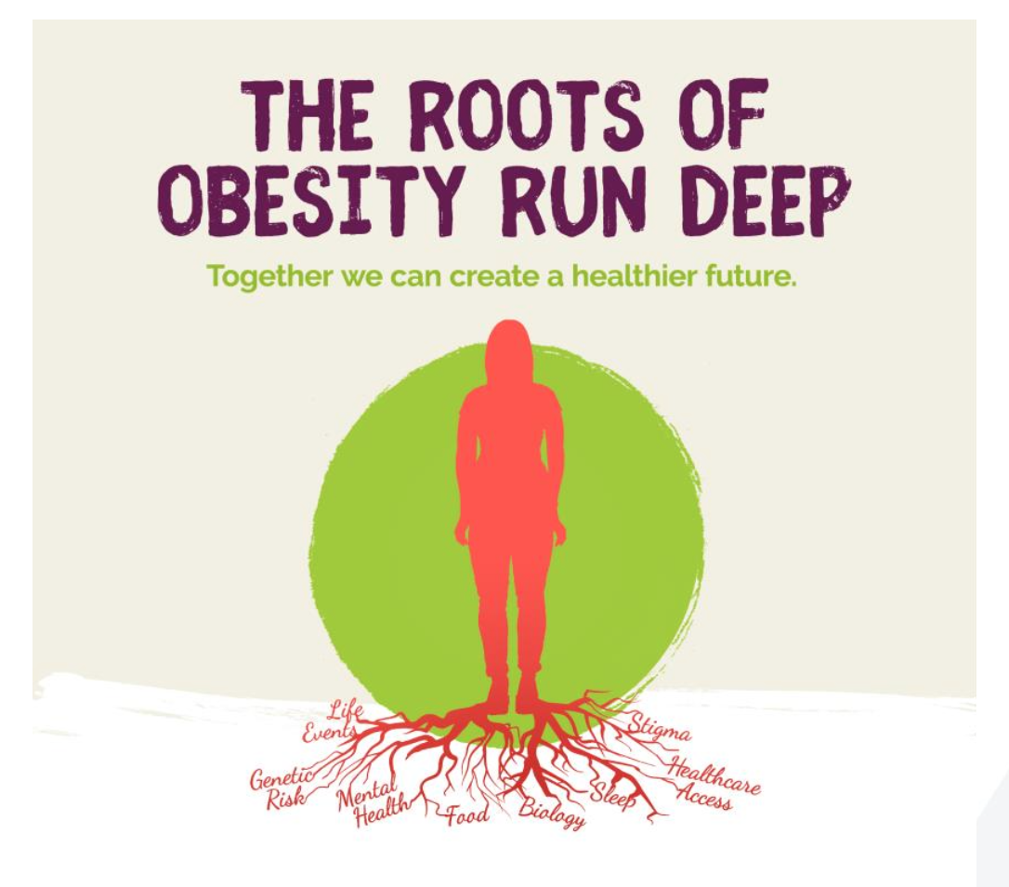

Slide 20
Avoid judgemental language
When talking about obesity, it is not uncommon for individuals to use certain words for dramatic effect.

Slide 21
Active listening
(NHS England)
The keys to successful listening are being able to withhold your own assumptions (even temporarily) to prevent jumping to conclusions, demonstrating a genuine interest in the person you are listening to and trying to empathise with their position.
True, active listening takes concentration, but will demonstrate your interest in others’ views, gain trust and enable you to gain a deeper understanding of issues and situations.

Slide 22
How to use Active Listening
1. Define terms to promote clarity
2. Repeat/Paraphrase
3. Do NOT interrupt
4. Listen “between the lines”
5. Do NOT rush to fill silences
6. Feedback impressions

Slide 23
References
https://www.goodtherapy.org/learn-about-therapy/types/dance-movement-therapy
Werder O. Toward a humanistic model in health communication. Global Health Promotion. 2019;26(1):33-40. doi:10.1177/1757975916683385
Puhl RM, Brownell KD. Confronting and coping with weight stigma: an investigation of overweight and obese adults. Obesity (Silver Spring). 2006 Oct;14(10):1802-15. doi: 10.1038/oby.2006.208. PMID: 17062811
Active listening | NHS England
https://www.obesityaction.org/action-through-advocacy/weight-bias/people-first-language/
chrome-extension://nlaealbpbmpioeidemdfedkfmglobidl/https://www.worldobesity.org/downloads/healthy_voices_downloads/HV_Language_guidelines.pdf
https://www.worldobesity.org/what-we-do/our-policy-priorities/weight-stigma#:~:text=Weight%20stigma%20is%20a%20result,can%20lead%20to%20stigmatising%20acts.
https://www.britannica.com/dictionary/stigma#:~:text=1,stigma%20attached%20to%20receiving%20welfare .

Slide 24
References
‘Surgeons of the Soul’ – Kipling speaking to the Royal College of Surgeons (London), 1923
Deviance and Social Stigma. (2021, February 20). https://socialsci.libretexts.org/@go/page/8123
Hilpert, Martin et al. “Sociocultural Influence on Obesity and Lifestyle in Children: A Study of Daily Activities, Leisure Time Behavior, Motor Skills, and Weight Status.” Obesity facts vol. 10,3 (2017): 168-178. doi:10.1159/000464105
Lee, G C et al. “When are anti-fat attitudes understood as prejudice versus truth? An experimental study of social influence effects.” Obesity science & practice vol. 5,1 28-35. 13 Jan. 2019, doi:10.1002/osp4.315
Daníelsdóttir, Sigrún et al. “Anti-fat prejudice reduction: a review of published studies.” Obesity facts vol. 3,1 (2010): 47-58. doi:10.1159/000277067
Frank A. Futility and Avoidance: Medical Professionals in the Treatment of Obesity. JAMA. 1993;269(16):2132–2133. doi:10.1001/jama.1993.03500160102
https://www.who.int/health-topics/obesity#tab=tab_2
La Arteterapia como terapia para pacientes con trastornos de la conducta alimentaria
in Anorexia y Bulimia, Profesionales TCA, Recursos TCA, Testimonios
6, octubre, 2016

Slide 25
