Slide 1
Exercise therapy in treating obesity – definition, significance and application Sanja Mazić·Danka Sinadinović· Stevan Mijomanović· Irena Aleksić-Hajduković
Connected 4 Health

Slide 2
Project Number: 2021-1-RO01- KA220-HED-38B739A3
The European Commission's support for the production of this presentation does not constitute an endorsement of the contents, which reflect the views only of the authors, and the Commission cannot be held responsible for any use which may be made of the information contained therein.

Slide 3
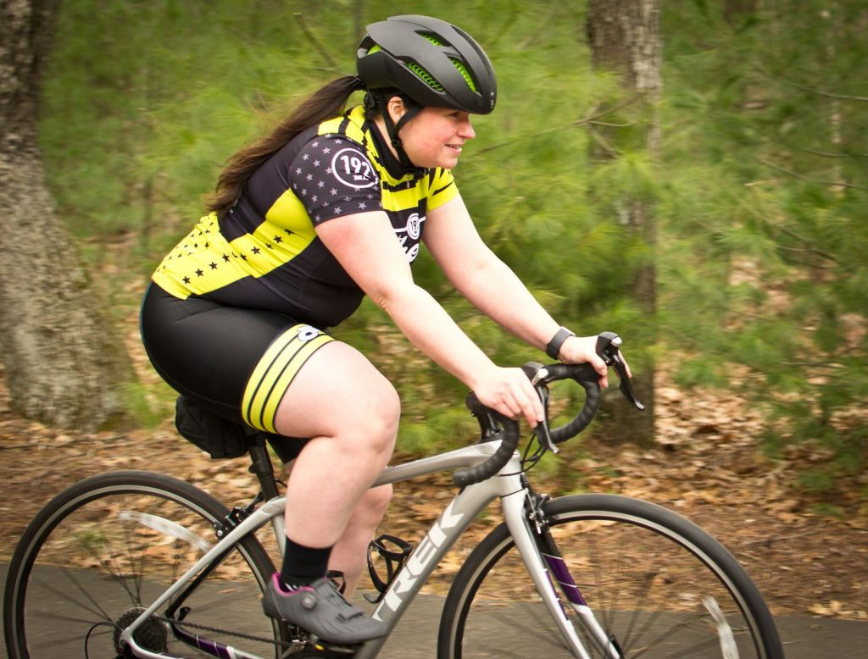
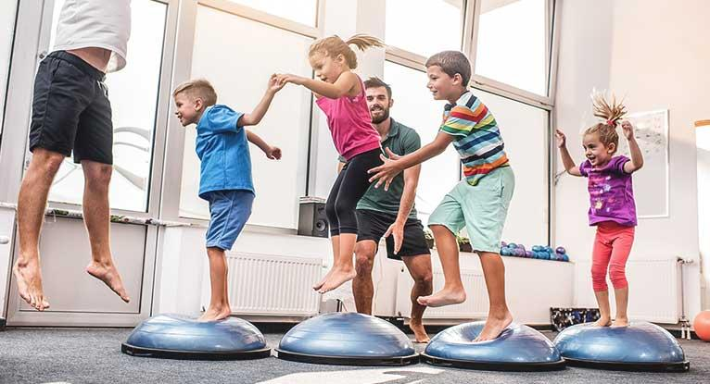
Definition of terms
Physical activity
any body movement produced by skeletal muscles that results in energy expenditure above resting (basal) levels
energy expenditure measured in two ways – MET (Metabolic Equivalents of Task) and Kcal (kilocalorie)
It broadly encompasses exercise, sports, and physical activities done as part of daily living, occupation, leisure, and active transportation
Exercise
physical activity that is planned, structured, and repetitive has as its final or intermediate objective the improvement maintenance of physical fitness

Slide 4
Definition of terms
Physical fitness
ability to carry out daily tasks with vigor and alertness, without undue fatigue and with ample energy to enjoy [leisure] pursuits and to meet unforeseen emergencies
It is operationalized as measurable health and skill-related attributes that include cardiorespiratory fitness, muscular strength and endurance, body composition and flexibility, balance, agility, reaction time and power
Physical inactivity
insufficient physical activity level to meet present physical activity recommendations
< 60 min/day of MVPA

Slide 5
Definition of terms
Energy expenditure
MET - the ratio of the rate of energy expended during an activity to the rate of energy expended at rest
one MET is the rate of EE while sitting at rest ; it is equal to oxygen uptake of 3.5 mL ∙ kg⁻¹ ∙ min⁻¹
Kcal - The energy needed to increase the temperature of 1 kg of water by 1° C
you can convert MET to kcal ∙ min⁻¹ :
kcal · min⁻¹ = [(METs × 3.5 mL ∙ kg⁻¹ ∙ min⁻¹ × body WT in kg) ÷ 1000)] × 5
EXAMPLE of energy expenditure:
Jogging ( at ~7 METs) for 30 min on 3 d ∙ wk⁻¹ for a 50 kg male:
7 METs × 30 min × 3 times per week = 630 MET-min · wk⁻¹
[(7 METs × 3.5 mL ∙ kg⁻¹ ∙ min⁻¹ × 50 kg) ÷ 1000)] × 5 = 6.125 kcal · min⁻¹
6.125 kcal ∙ min⁻¹ × 30 min × 3 times per week = 551.25 kcal · wk⁻¹

Slide 6
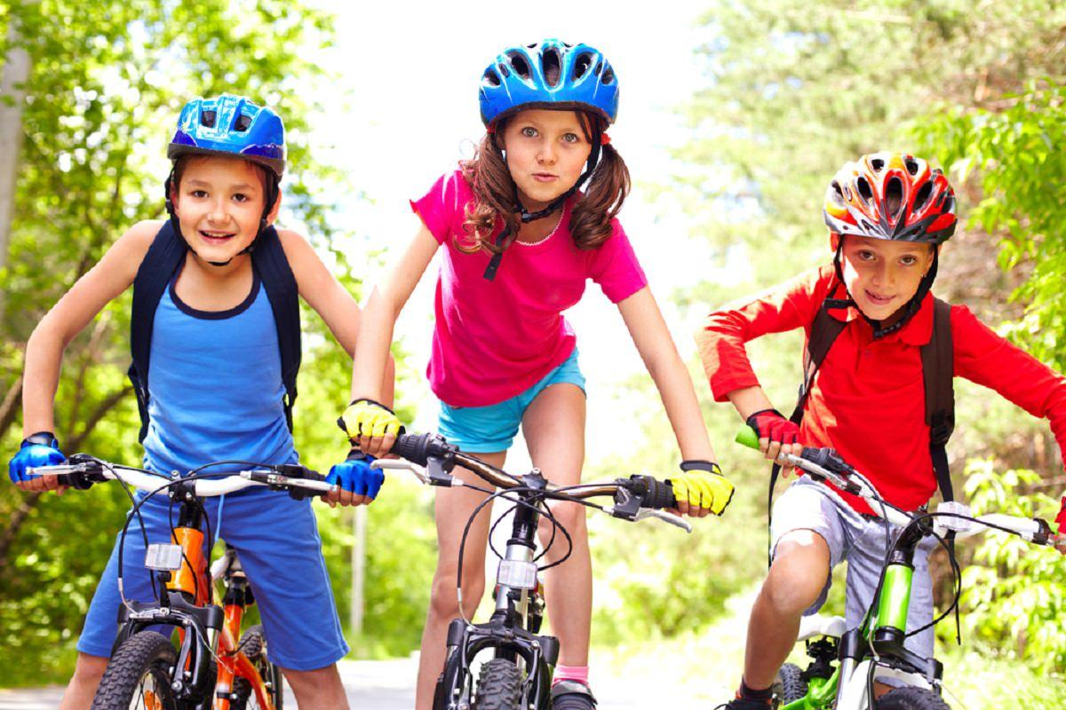

Slide 7
Effects of physical activity

Slide 8
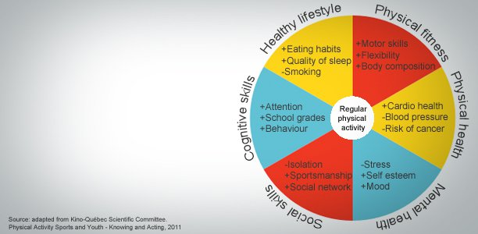
Effects of physical activity

Slide 9
Physical activity – general recommentations
Global recommendations on physical activities for health, WHO, 2011
physical activity should not be mistaken for sport
it includes sports, exercise, playing, walking, doing household chores
moderate-intensity and vigorous-intensity physical activity
‘how hard a person works to perform a physical activity’
moderate –intensity activities: e.g. dancing, brisk walking, chores
vigorous-intensity activities: e.g. running, fast cycling, fast swimming
accmulating physical activity throughout the week
meeting the goal of 60 minutes per day or 150 minutes per week by performing activities in multiple shorter bouts
doing some physical activity is better than doing none
added health benefits when becoming more active

Slide 10
Recommendations for children 5-17 years old
get at least 60 minutes of moderate- to vigorous-intensity physical activity per day, mostly aerobic
vigorous-intensity activity included at least 3 days per week
muscle- and bone-strengthening (weight-bearing) activities included at least 3 days per week
Increase amount and intensity gradually over time
HOME-BASED ACTIVITY
60 minutes of physical activity a day for good health, but necessarily all at once
Several short 10-minute, or even 5-minute, bursts of activity throughout the day can be just as good as an hour-long stretch

Slide 11
Physical activity – recommendations for overweight and obese children
obesity in childhood is associated with metabolic,cardiorespiratory, cardiovascular, hepatic, gastrointestinal, genitourinary, musculoskeletal complications, mental health conditions
necessary to check for any comorbidities before implementing a program of physical activity!
guidelines predominantly recommend delivery of multi-component behaviour-change interventions aimed at improving nutrition and physical activity accompanied with age-appropriate, culturally sensitive, family-centered lifestyle modifications
parental/family participation in treatment is widely encouraged especially for children under the age of 12 whereby parents/families can be role models and agents of change
tailored or personalized approach - physical activity should be appropriate for the child’s age, interests and ability in order to encourage and maintain engagement

Slide 12
Physical activity – recommendations for overweight and obese children
EXERCISE THERAPY
extremely overweight children don't need to do more exercise than slimmer children; their extra body weight means they will naturally burn more calories for the same activity
more than 60 min per day may be necessary for those that are extremely overweight; gradual increase from 20 to 60 min a day
home-based activity
role model, family business, interesting, funny, enjoyable...
tailored, supervised program
exercise is medicine and medicine has to be prescribed

Slide 13
Physical activity – recommendations for overweight and obese children
FITT Principle
- F Frequency
- I Intensity
- T Time
- T Type

Slide 14
FITT principle
F Frequency
How often will you do the activity — once a day, three times a week, twice a month? - Be active every day!
I – Intensity
How much energy is needed—light vs. vigorous activity? - Combination of moderate and vigorous physical activity!
moderate intensity activities raise your heart rate, and make you breathe faster and feel warmer (when you can still talk, but not sing!)
vigorous intensity activities raise your heart rate, make you breathe faster, you feel warmer and start to sweet (you are not able to say more than a few words without pausing for breath!)
<3 MET low < 3,5 kcal/min
3 – 6 MET moderate 3.5 to 7 kcal/min
> 6 MET vigorous > 7 kcal/min

Slide 15
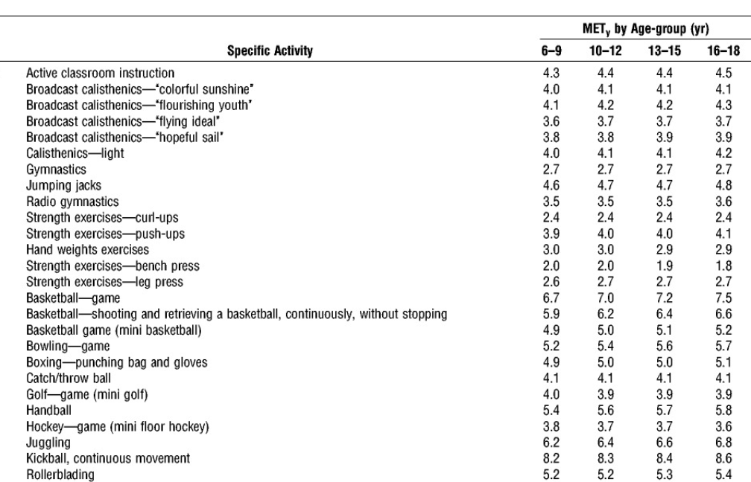
Example

Slide 16
Calculation-Caloric Cost of Exercise
MET x 3.5 x body weight in Kg/200 = kcal/min
Example: Body weighing 60 kg exercising at 7 MET on treadmill. How much calories shall he expend for 30 min?
7 x 3.5 x 60/200 = 7.35 or 7 kcal/min x 30
Caloric cost per 30 min of exercise = 210 kcal
Balady GJ, Cardiology Clinics, Vol 19, No.3 Aug 2001

Slide 17
FITT principle
T Time
How long does the exercise session take—20 minutes, 1 hour, 30 minutes split into two sessions in one day? - aim for an average of at least 60 minutes of moderate or vigorous intensity physical activity a day across the week
T Type
Children and young people need to do 2 types of physical activity each week:
aerobic exercise
exercises to strengthen their muscles and bones

Slide 18
Type of physical activity
Aerobic/cardiovascular
activities that are intense enough and performed long enough to maintain or improve one’s heart and lung fitness
examples: walking, jogging, dancing, cycling, basketball, soccer, swimming
Muscle-strengthening
referred to as resistance training
these activities maintain or increase muscle strength, endurance, and power
examples: weight machines, free weights, resistance elastic bands, Pilates, everyday activities (lifting children, carrying groceries or laundry, climbing stairs)

Slide 19
Type of physical activity
Flexibility training
referred to as stretching; lengthening or flexing a skeletal muscle to the point of tension and holding for several seconds to increase elasticity and a range of motion around the joint; improving flexibility can enhance the overall physical performance of other types of exercise
Examples: dynamic stretches performed with movement (yoga, tai chi), static stretches without movement (holding a pose for several seconds or longer), passive stretching (using an external force like a strap or wall to hold an elongated pose), and active stretching (holding a pose without an external force)

Slide 20
Type of physical activity
Balance training
these activities are intended to throw off one’s balance to improve body control and stability; they can help to prevent falls and other injuries
examples: standing on one foot, walking heel-to-toe in a perfectly straight line, standing on a balance or wobble board

Slide 21
Tips for implementation
take history, especially personal history, and check if there are any comorbidities (e.g. diabetes, high blood pressure, musculoskeletal problems, etc.)
assess body height (BH), body weight (BW), BMI, %BF
choose physical activity that is interesting and fun for the child
start with low intensity activities
increase intensity over time

Slide 22
Outcome
weight loss
for children presenting with BMI ≥99.6th percentile, a gradual weight loss to a maximum of 0.5–1.0 kg per month is acceptable
2. total cholesterol, triglycerides, high-density-lipoprotein (HDL) cholesterol, low-density-lipoprotein (LDL) cholesterol, two-hour fasting blood glucose, systolic blood pressure, diastolic blood pressure, overall quality of life and physical fitness

Slide 24
Literature
Busnatu, S.S.; Serbanoiu, L.I.; Lacraru, A.E.; Andrei, C.L.; Jercalau, C.E.; Stoian, M.; Stoian, A. Effects of Exercise in Improving Cardiometabolic Risk Factors in Overweight Children: A Systematic Review and Meta-Analysis. Healthcare 2022, 10, 82
Bull, F.C.; Al-Ansari, S.S.; Biddle, S.; Borodulin, K.; Buman, M.P.; Cardon, G.; Carty, C.; Chaput, J.P.; Chastin, S.; Chou, R.; et al. World Health Organization 2020 guidelines on physical activity and sedentary behaviour. Br. J. Sports Med. 2020, 54, 1451–1462.
García-Hermoso, A.; Ramírez-Vélez, R.; Ramírez-Campillo, R.; Peterson, M.D.; Martínez-Vizcaíno, V. Concurrent aerobic plus resistance exercise versus aerobic exercise alone to improve health outcomes in paediatric obesity: A systematic review and meta-analysis. Br. J. Sports Med. 2018, 52, 161–166. [CrossRef] [PubMed]
Li, D.; Chen, P. The Effects of Different Exercise Modalities in the Treatment of Cardiometabolic Risk Factors in Obese Adolescents with Sedentary Behavior-A Systematic Review and Meta-Analysis of Randomized Controlled Trials. Children 2021, 8, 1062. [CrossRef]

Slide 25
Literature
Ells, L.J.; Rees, K.; Brown, T.; Mead, E.; Al-Khudairy, L.; Azevedo, L.; McGeechan, G.J.; Baur, L.; Loveman, E.; Clements, H. Interventions for treating children and adolescents with overweight and obesity: An overview of Cochrane reviews. Int. J. Obes. 2018, 42, 1823–1833. [CrossRef] [PubMed]
Guidelines for treating child and adolescent obesity: A systematic review, Front Nutr. 2022; 9: 902865. Published online 2022 Oct 12. doi: 10.3389/fnut.2022.902865 Louise Tully, ¹ Niamh Arthurs, ^{1 , 2} Cathy Wyse, ¹ Sarah Browne, ³ Lucinda Case, ² Lois McCrea, ² Jean M. O’Connell, ⁴ Clodagh S. O’Gorman, ^{5 , 6} Susan M. Smith, ⁷ Aisling Walsh, ⁸ Fiona Ward, ⁹ and Grace O’Malley ^{1 , 2 ,}

