Slide 1
Foot imaging and its challenges Author: Gabriele Guogyte
Connected 4 Health

Slide 2
Project Number: 2021-1-RO01- KA220-HED-38B739A3
The European Commission's support for the production of this presentation does not constitute an endorsement of the contents, which reflect the views only of the authors, and the Commission cannot be held responsible for any use which may be made of the information contained therein.

Slide 3
Lotus foot
We will start our journey with history
The ideal beauty in ancient China had to have a lotus foot.
From the age of 4-5, girls' feet were tied so that they would meet the standard of beauty when they grew up.
It is difficult for us to understand the pain that awaited these girls before they were sold. Unfortunately, not all of them were so "lucky", many died of infections and it was a very painful death, the rest could not walk on their own.
Of course, such images and stories disgust us and we hardly understand such a tradition.

Slide 4
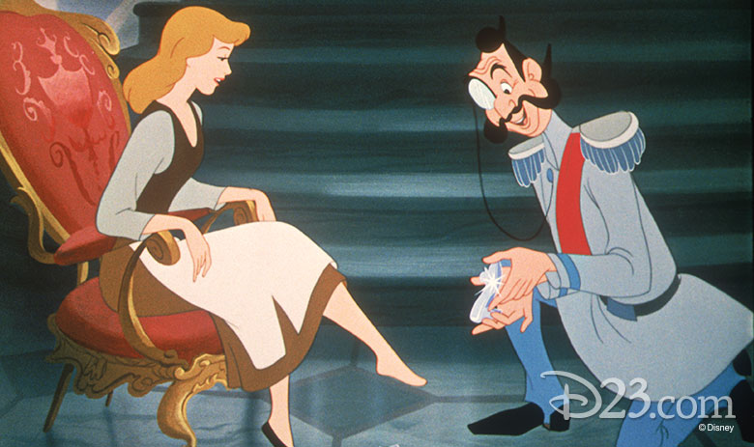
Cinderella
Let's go back to our childhood.
The Cinderella story that children know and love teaches us that dreams do come true. The story of how Cinderella leaves her shoe for a prince in love. And he's looking for a woman whose foot fits the shoe to make her his princess. Unfortunately, all women in the kingdom had larger feet. The prince visits Cinderella's house. One of Cinderella's sisters cuts off her toe, the other cuts off her heel to fit the shoe. But it doesn't help. Finally, Cinderella tries on the shoe, which fits, and marries the prince.
In the picture, we can see that the anatomically depicted leg of the character does not correspond to the proportions of the body. In reality, Cinderella could hardly walk gracefully with such a foot.

Slide 5
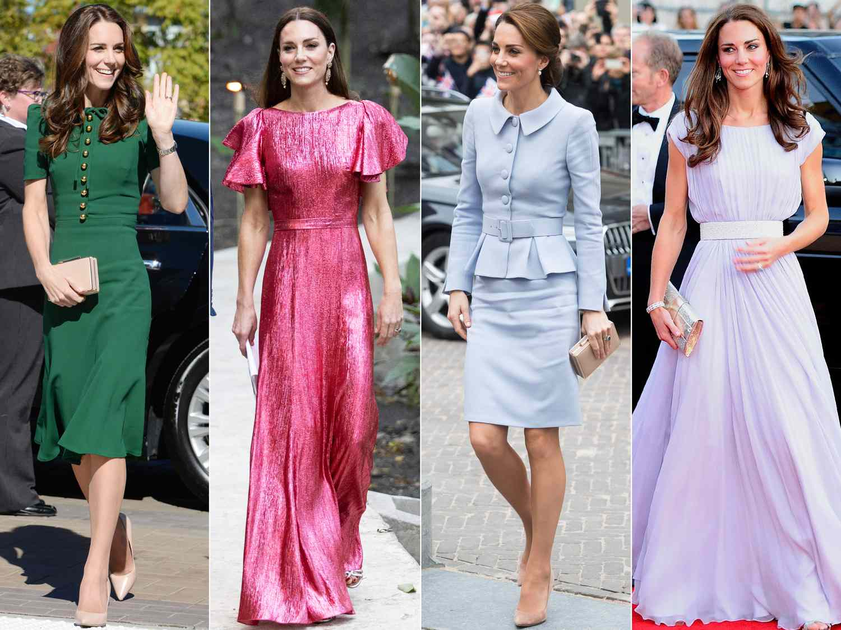
How many girls in the world dream of being the Cinderella who turns into a princess as a child?
The aspiration formed in our subconscious mind is like a vision of a happy future.

Slide 6
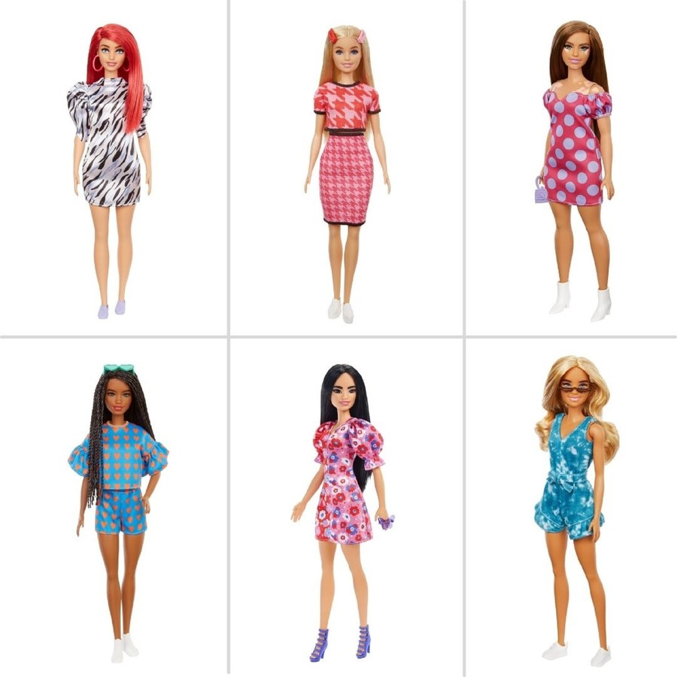
Barbie
The Barbie doll is a standard of beauty that countless girls have grown up with.
Please note that anatomically the foot of the doll is depicted as small. A woman with such a foot could hardly walk gracefully and easily.

Slide 7
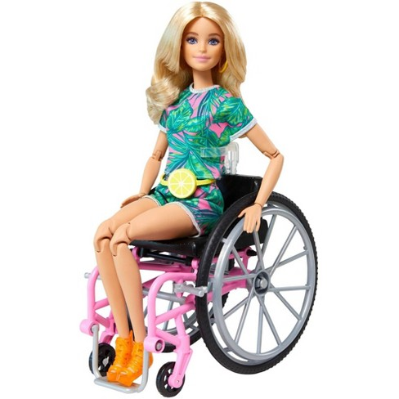
It's sad, but this image is more realistic for this foot-to-body ratio

Slide 8
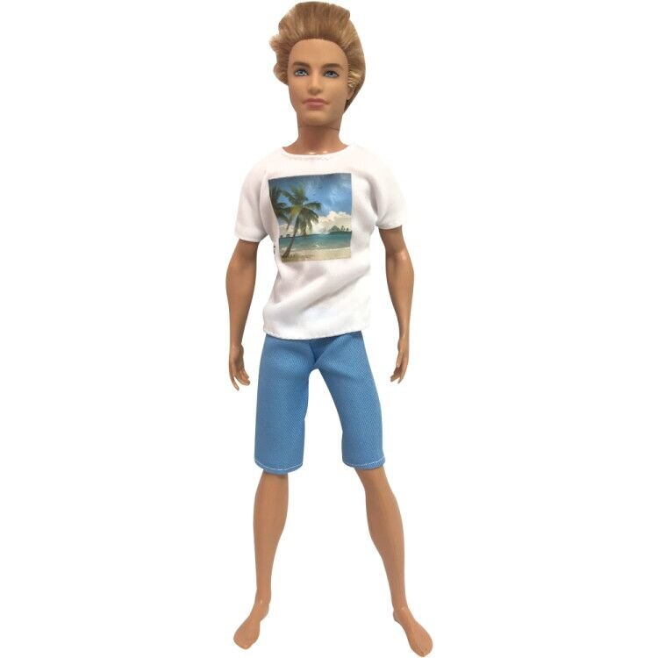
What is the image of a dream man for Barbie fans?
Proportion is maintained like Barbie dolls, i.e. the foot does not anatomically correspond to the body structure.

Slide 9
These examples of Cinderella, Barbie, and similar characters lie very deeply in the child's subconscious and later remain in the subconscious of a mature person.
How difficult is it to erase that model of beauty perfection?

Slide 10
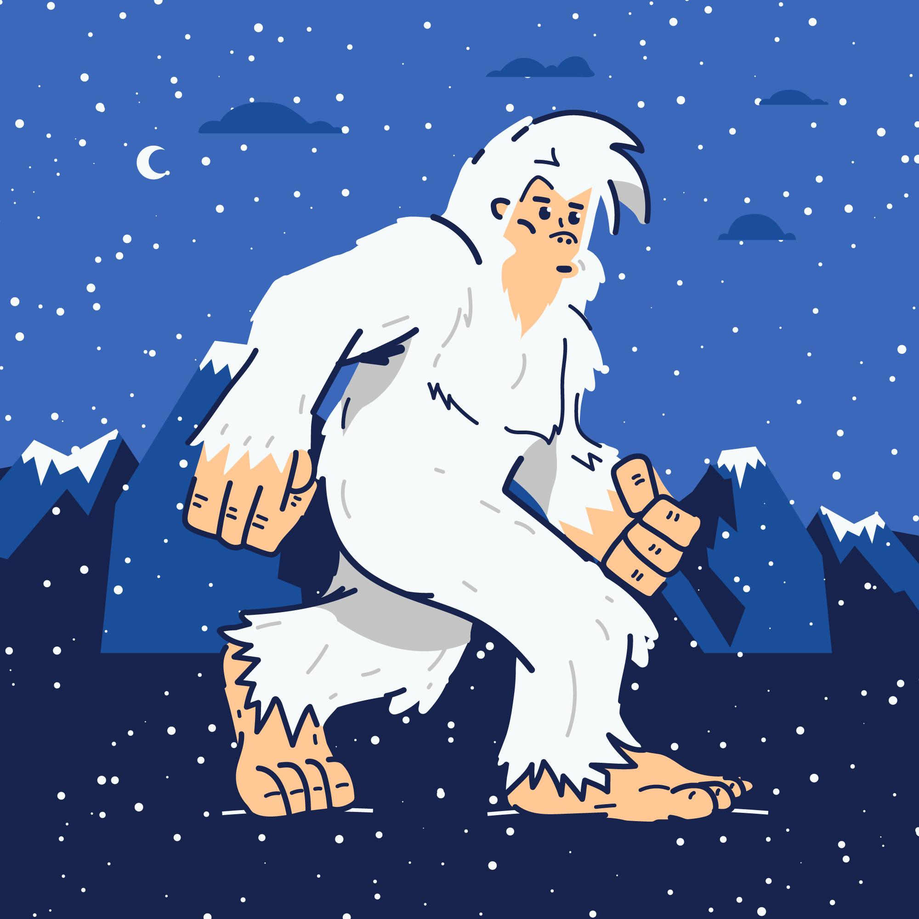
Bigfoot
A mystical creature that is presented as something wild, uncivilized.
It's called Bigfoot - a creature with big feet
The message encoded in the subconscious mind is that big feet are ugly, uncivilized and something horrible
Image designed by Freepik

Slide 11
Impact of the beauty industry
The beauty industry is one of the forms of management that shapes our perception of the world, habits, nutrition, daily activities, body standards, and perception of beauty.
This information reaches us quickly, easily, directly and indirectly. Information sources starting from TV, Internet, magazines, billboards, flyers, and observing the behavior of others.
How have the Lotus feet remained till our days and what do they symbolize nowadays?
Is a modern self-confident woman shrinking her foot?
Has this tradition made its way into the world of men already?

