Slide 1
Peculiarities of foot care for patients with type II diabetes Author: Gabriele Guogyte
Connected 4 Health

Slide 2
Project Number: 2021-1-RO01- KA220-HED-38B739A3
The European Commission's support for the production of this presentation does not constitute an endorsement of the contents, which reflect the views only of the authors, and the Commission cannot be held responsible for any use which may be made of the information contained therein.

Slide 3
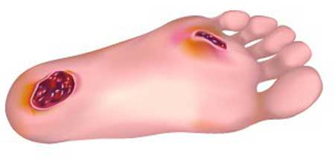
Diabetic foot syndrome
The development of diabetic foot syndrome can be dangerous for all patients with diabetes.

Slide 4
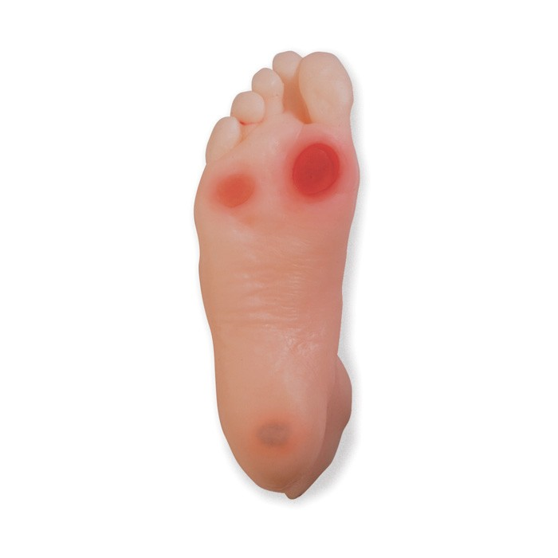
Diabetic foot symptoms
pain sensation disorder in the legs and feet (neuropathy)
impaired blood circulation, insufficient blood supply to the feet
delayed wound healing
skin lesions, calluses, hardened epidermis, abscesses and inflammations
deformed foot bones

Slide 5
The main outcomes of the diabetic foot are ulcers and amputations
Every 30 seconds a diabetic foot is amputated in the world

Slide 6
Basic elements of diabetic foot care

Slide 7
Washing feet
before washing the feet, it is needed to measure the temperature of the water with a thermometer
wash the feet with warm (37°C) running water
choose children's or neutral soap

Slide 8
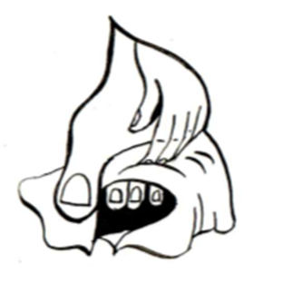
Between the toes
thoroughly dry between the toes
use a separate towel for the feet
after drying, massage with cream or foam

Slide 9
Foot examination
it is mandatory to check feet every day
if it's difficult for a patient to do this on his/her own, they should use a mirror or ask someone for help

Slide 10
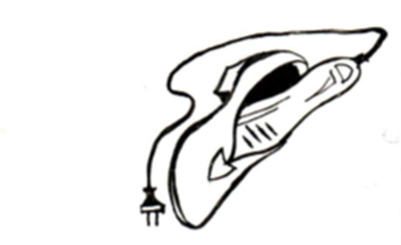
Shoe care
it is recommended to use a shoe dryer

Slide 11
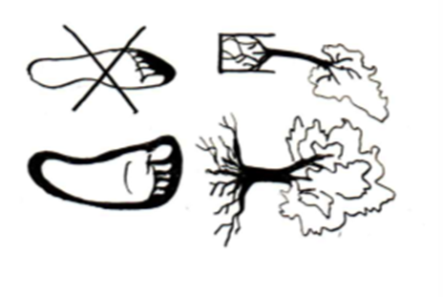
The right footwear helps prevent:
foot deformities,
painful calluses,
interdigital eruptions,
ingrown and deformed nails,
formation of ulcers.

Slide 12
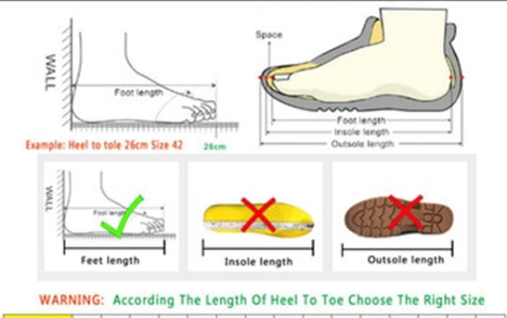
How to choose the right footware?

Slide 13
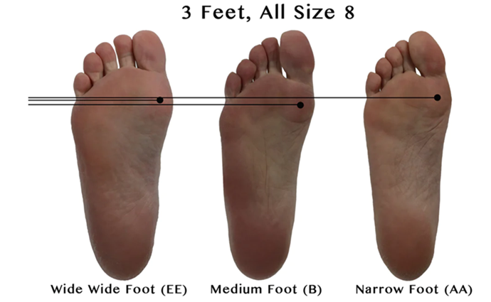
What is the width of a foot?
Forefoot circumference (behind toes)
Metatarsal girth
Forefoot width
Heel width

Slide 14
Effects of improper footwear

Slide 15
Ingrown nail and calluses

Slide 16
Onychodystrophy

Slide 17
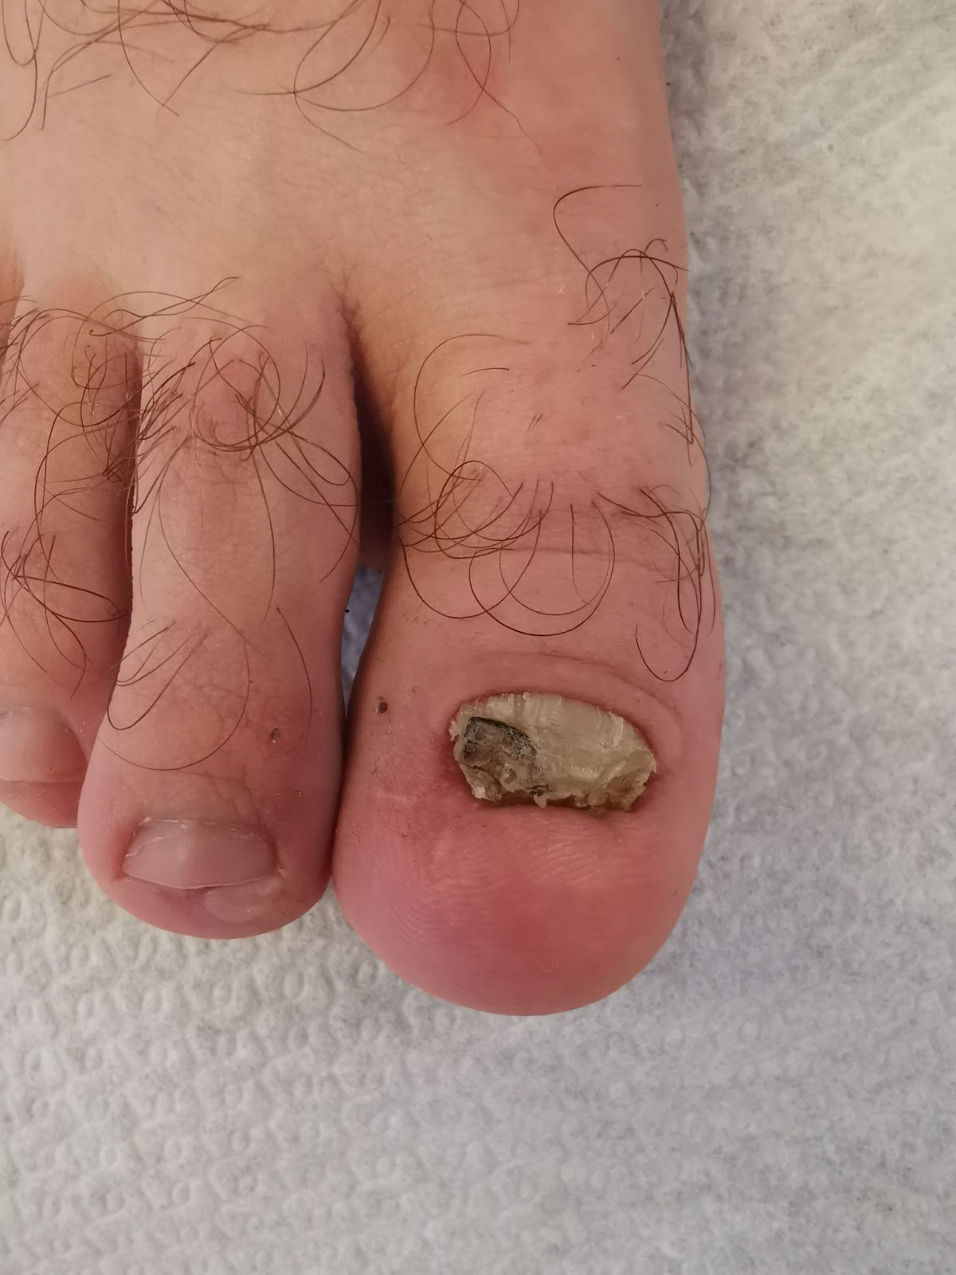
Onychodystrophy

Slide 18
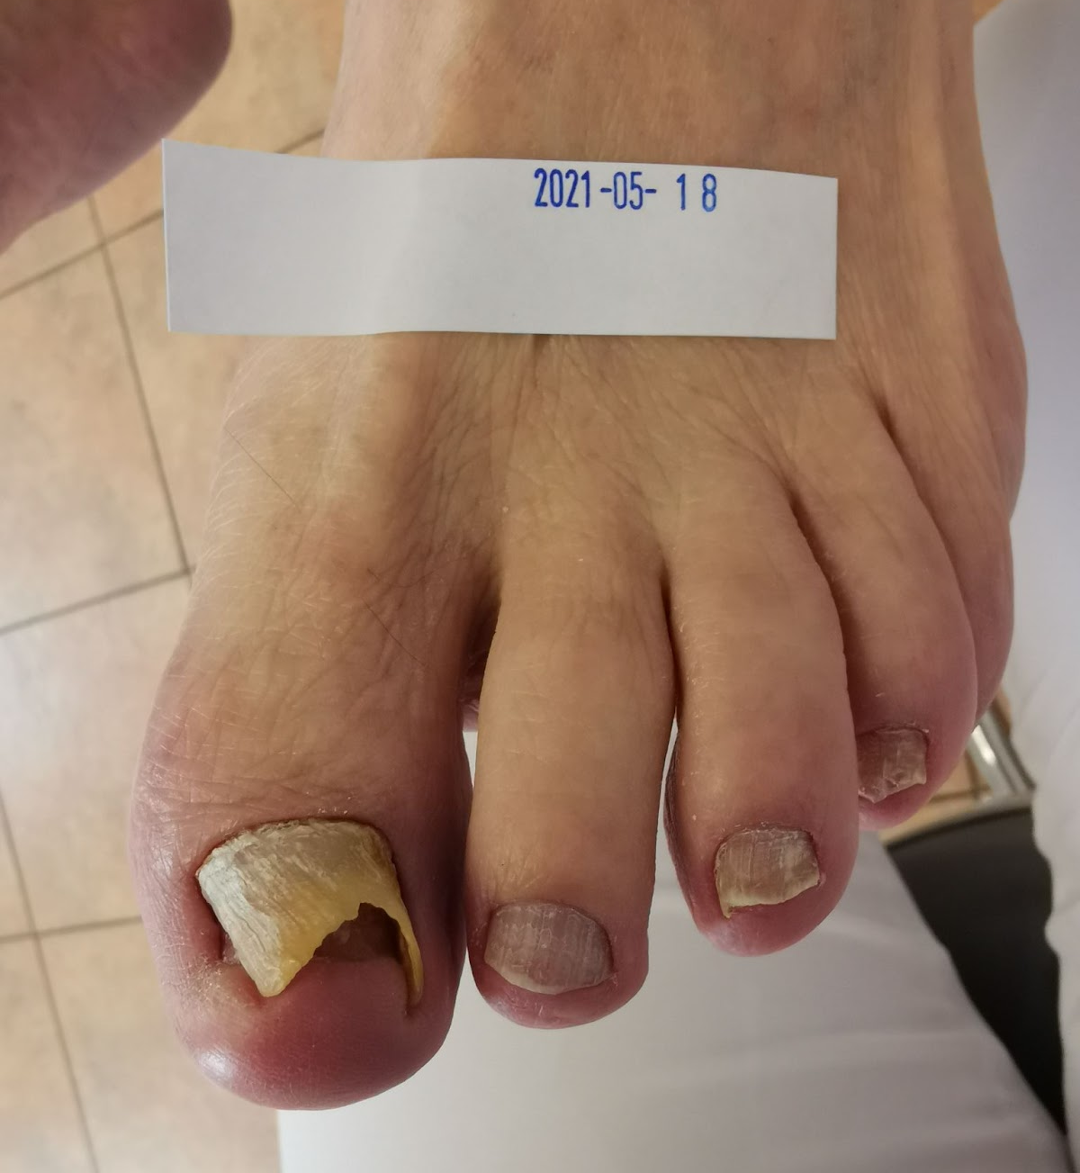
Onychodystrophy

Slide 19
Do not walk barefoot
never walk barefoot (especially on the beach)

Slide 20
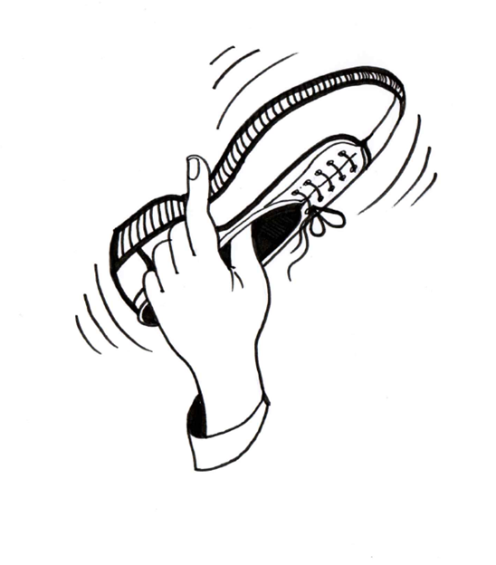
Check the inside of the shoe
Check the inside of the shoe.
It cannot contain sand, pebbles, or other small particles

Slide 21
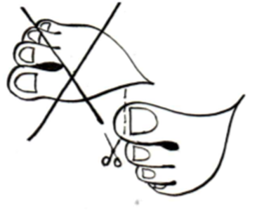
Nail trimming
cut nails in a straight line
don't cut corners
do not cut too short
monitor the condition of the toes after wearing shoes (redness, discomfort, pain, numbness)
incorrect nail cutting - the risk of an ingrown nail or a change in the shape of the nail

Slide 22
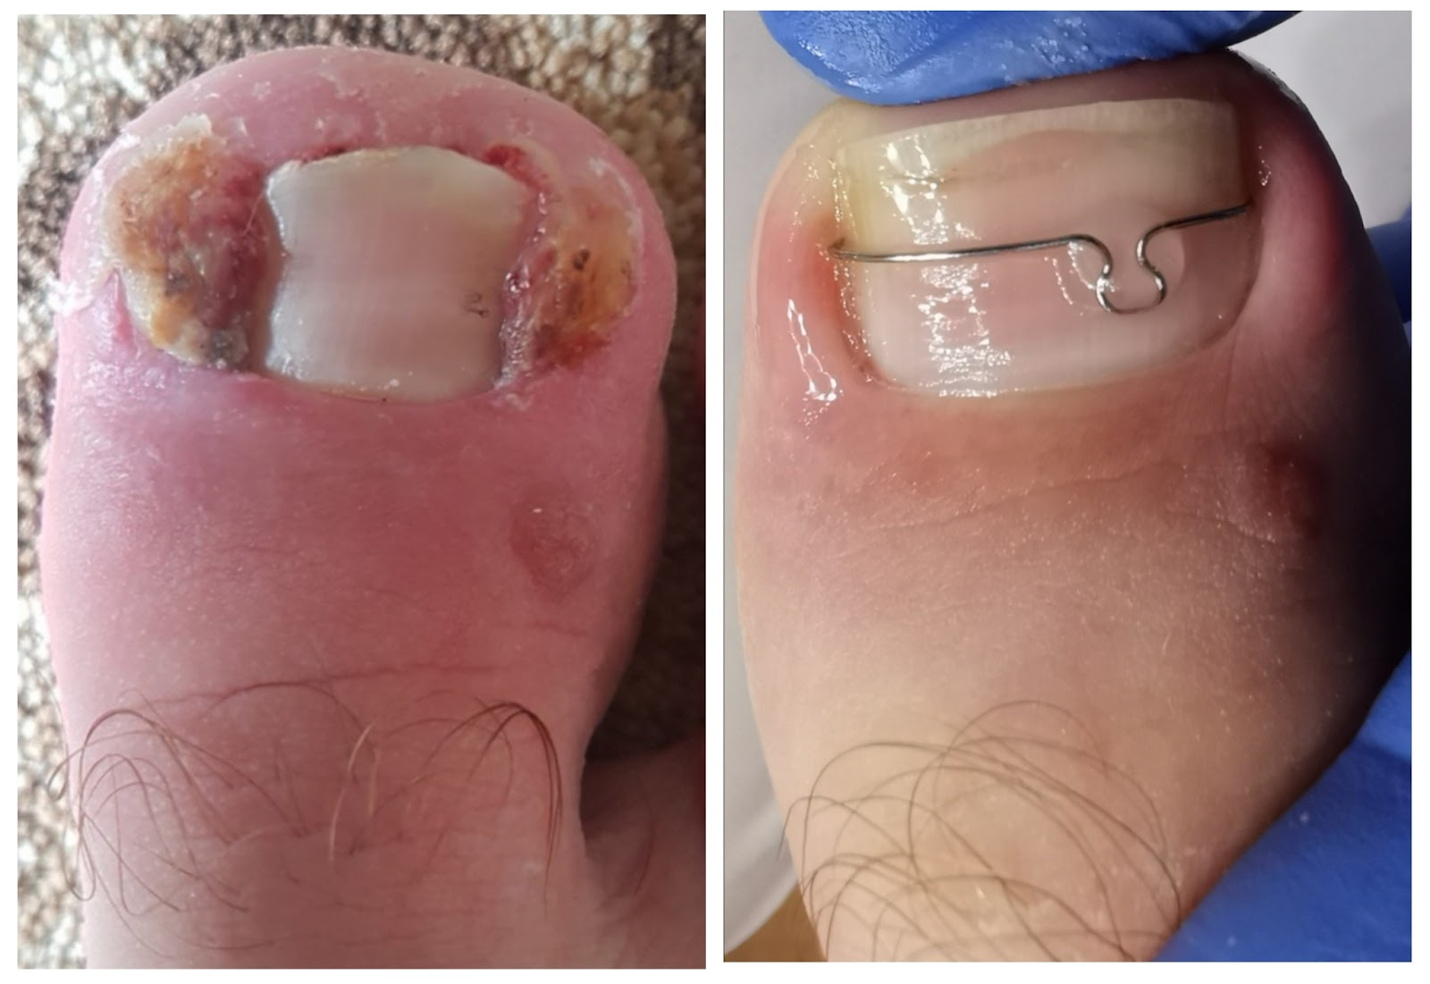
Consequences of improper nail cutting

Slide 23
To sum up
Every day:
wash the feet with warm water and baby soap
dry carefully, especially between the toes
carefully inspect for any damage
massage the feet with cream except between the toes
check the inside of the shoe
do not walk barefoot
at the slightest wound contact a specialist as it is important not to delay treatment.

Slide 24
Images by
Gabriele Guogyte

Slide 25
References
Berdikšlienė A. Pėdų priežiūra. Diabeto IQ, 2021, 5(13): 30-32. https://dia-iq.lt/wp-content/uploads/2021/10/DIQ-13.pdf
Kostkevičius G, Astromskas AR. Visos bėdos dėl pėdos. 2010: Verslo Respublika, Kaunas.
Kostkevičius G, Kušvidas V. Pėdos ir batai arba kaip nusipirkti tinkamus ir patogius sportinius bei žygio batus. 2010: Verslo Respublika, Kaunas.
Scholz N. Lehrbuch und Bildatlas für die Podologie. 2012: Neuer Merkur.

