Slide 1
Basics of CBT Authors: Simona Cakirpaloglu, Lukas Merz
Connected 4 Health

Slide 2
Project Number: 2021-1-RO01- KA220-HED-38B739A3
The European Commission's support for the production of this presentation does not constitute an endorsement of the contents, which reflect the views only of the authors, and the Commission cannot be held responsible for any use which may be made of the information contained therein.

Slide 3
Eating disorder warning signs
In the beginning, it may be difficult to recognise an individual with an eating disorder, because the illness develops over time
There are some warning signs that can indicate there is a problem. Not all of them have to present at the same time. These include:
Behavioural warning signs
Psychological warning signs
Physical warning signs

Slide 4
Behavioural warning signs
Constant or repetitive dieting (e.g. counting calories/kilojoules, skipping meals, fasting, avoidance of certain food groups or types such as meat or dairy, replacing meals with fluids)
Evidence of binge eating (e.g. disappearance of large amounts of food from the cupboard or fridge, wrappers appearing in bin, hoarding of food in preparation for bingeing)
Evidence of vomiting or laxative abuse (e.g. frequent trips to the bathroom during or shortly after meals)
Excessive or compulsive exercise patterns (e.g. exercising at all times, insistence on performance)

Slide 5
Behavioural warning signs
Changes in food preferences (e.g. refusing to eat certain foods, dislike of foods previously enjoyed, sudden interest in ‘healthy diet’)
Avoidance of social situations involving food
Strong focus on body shape and weight (e.g. interest in weight-loss websites, dieting tips in books and magazines, images of thin people)
Social withdrawal and isolation from friends, including avoidance of previously enjoyed activities
Change in eating pace (e.g. eating with teaspoons, eating one at a time, rearranging food on plate)

Slide 6
Psychological warning signs
Increased interest in body shape, weight and appearance
Intense fear of gaining weight
Constant preoccupation with food or with activities relating to food (e.g. food preparation, food blogs, groups on social media)
Body dissatisfaction/ negative body image
Distorted body image (e.g. complaining of being fat, feeling or looking plump when with the right, healthy weight or even underweight)

Slide 7
Psychological warning signs
Sensitivity to comments or criticism about exercise habits, body shape, eating or weight
Anxiety around meal times
Depression or anxiety
Moodiness or irritability, mood swings
Low self-esteem (e.g. feeling worthless, guilt, shame or self-loathing)
‘Black and white’ thinking (distorted views that everything is either ‘good’ or ‘bad’)

Slide 8
Physical warning signs
Sudden or rapid weight loss or weight gain (in bulimia)
Frequent changes in weight
Loss of menstrual periods in women
Signs of frequent vomiting
Fainting, dizziness
Fatigue —feeling tired, unable to perform normal activities
Watch a short video summary on https://youtu.be/nJMtReAg1DI

Slide 9
Diagnosis
The diagnosis of an eating disorder usually lies with a doctor, who is often approached by patient’s relatives or caregivers. The doctor usually considers the person’s:
BMI, careful history related to eating habits and weight, physical examination, laboratory examination, basic psychiatric examination

Slide 10
Treatment
Depending on the severity, timely or late diagnosis, the general condition of the patient, the treatment can take the form of individual or group counselling, outpatient therapy, hospitalisation or metabolic ICU in life-threatening conditions. Physical, social, and psychological factors must be considered before the treatment.
The treatment always requires a close cooperation of a coordinated multidisciplinary team including a GP, psychologist, nutritional therapist, family members, sometimes occupational therapist, physiotherapist, dietician, etc.

Slide 11
Treatment
National guidelines and recommendations may differ across countries, but there are some general evidence-based principles that are the same and have proved successful in treating eating disorders. Treatment plans often include psychotherapy, medical care and monitoring, nutritional counselling, sometimes medications, or a combination of these approaches.
Typical treatment goals include:
Restoring adequate nutrition
Weight restoration to a healthy level
Reducing excessive exercise
Stopping binge-purge and binge-eating behaviours

Slide 12
Psychotherapy
The person with an ED develops and maintains an isolated inner world that keeps the illusion of personal control while losing of meaningful relationships with others. The treatment poses a threat to the illusive safety of this constructed inner world, and exposes the patient to the realities that he or she is trying to escape from. In connection with body-image distortion, patient resistance to treatment is inevitable. His or her psychological insight is very low or non-existent and adolescent patients are typically forced into treatment by parents. Understandably, the patient perceives the treatment providers as external threats — as enemies who will force the patient to undesired behaviour. To the patient, this is unacceptable.

Slide 13
Psychotherapy
There is a general recommendation that patients have individualised goals set for weekly weight gain and target weight. Patients should be treated with an eating disorder focused psychotherapy, which should include normalising eating and weight control behaviours, restoring weight, and addressing psychological aspects of the disorder (e.g. fear of weight gain, body image disturbance). To achieve these goals, the type of therapy that proved effective is so-called “cognitive behavioural therapy”. However, it is important to note that there is no single approach or intervention effective in all patients. There are many variations of eating disorders and treatment must be individualised.

Slide 14
What is CBT?
Cognitive behavioural therapy (CBT) is a form of psychotherapy or counselling therapy that focuses on thought patterns and how they affect our attitudes, our emotions and consequently our behaviours.
CBT was developed in the 1960’s by Aaron T. Beck and Albert Ellis at the University of Pennsylvania. They noticed the patients who presented to them for depression would have consistent streams of negative thoughts. By helping them re-evaluate those thoughts about themselves, about the world or their future, they were able to cope in everyday life and their symptoms improved. The CBT is about understanding what is going on around us here and now, how we are making sense of events around us, and how these events affect our emotions.

Slide 15
What is CBT?
In general, cognitive behavioral therapy assumes that changing the relation to a certain situation leads to change in the behavior and associated emotions. The goal of the therapy is to decide what can be altered and thus change the way certain situations are perceived and undesired behaviors prevented. In case of eating disorders, this means to reduce negative thoughts about eating, food and body image and remove the harmful behavior. The way our feelings, thought, and behavior are inseparable, intertwine and mutually affect one another is represented by a “cognitive triangle”.

Slide 16
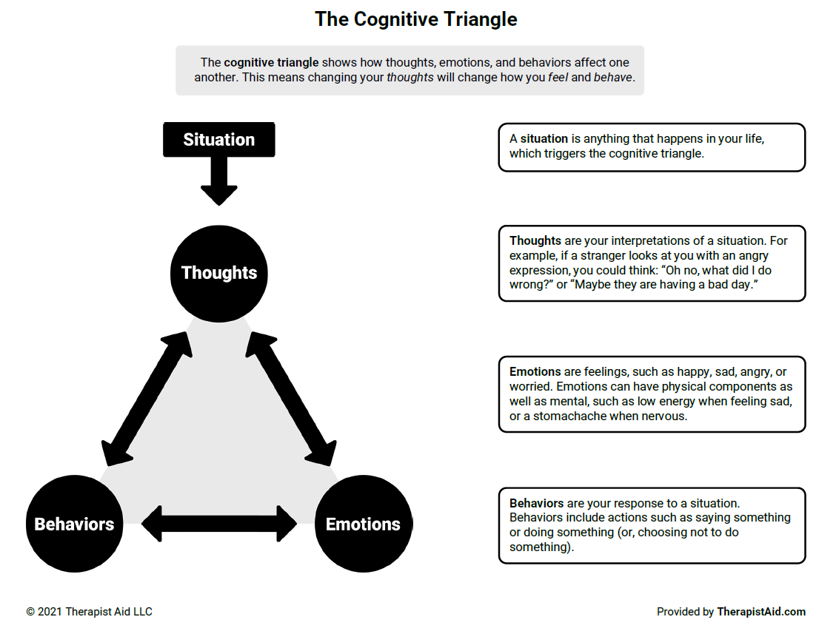
Cognitive triangle
By TherapistAid LLC, https://www.therapistaid.com/therapy-worksheet/cbt-triangle/cbt/none

Slide 17
Cognitive distortions
A problem arises, when our thoughts are distorted, namely by distorted opinions about body image, self-perception, weight, feelings of guilt, shame, or self-worthlessness. When this kind of thinking becomes habitual or default, it impacts our how we feel about ourselves and how we live. It creates a vicious circle of distorted thoughts, negative feelings, and harmful behavior.
The goal of psychotherapy for ED’s is to break this vicious circle and alter emotions, thought, and ultimately the behavior. This is called cognitive restructuring.

Slide 18
Therapy phases
CBT usually has six phases:
Assessment or psychological assessment;
Reconceptualization;
Skills acquisition;
Skills consolidation and application training;
Generalization and maintenance;
Post-treatment assessment follow-up.

Slide 19
Further reading
A summary of what CBT is can also be found in this video:
https://youtu.be/bUOaHsxe8OQ
For more detailed information in English on psychotherapy of ED’s, go to the National Institute for Health and Care Excellence (UK):
https://www.nice.org.uk/guidance/ng69/chapter/Recommendations
or The American Psychiatric Association Practice Guideline for the Treatment of Patients With Eating Disorders (USA)
https://ajp.psychiatryonline.org/doi/10.1176/appi.ajp.23180001

