Slide 1
Nutrition Diagnosis and Treatment Instituto Politécnico de Bragança
Connected 4 Health

Slide 2
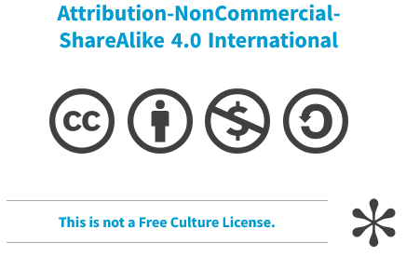
Project Number: 2021-1-RO01- KA220-HED-38B739A3
The European Commission's support for the production of this presentation does not constitute an endorsement of the contents, which reflect the views only of the authors, and the Commission cannot be held responsible for any use which may be made of the information contained therein.

Slide 3
PES Statement
The nutrition diagnosis is communicated as a structured sentence called PES Statement, which includes three distinct parts:
Problem
Etiology (root cause of the problem)
Symptomatology (proof of the problem, evidence from assessment data)
Problem RELATED TO etiology AS EVIDENCED BY signs and symptoms

Slide 4
Nutrition Treatment
Purpose: to plan and implement purposeful actions intended to positively change or improve a nutrition related problem.
Directed at the etiology or cause of the problem identified in the PES

Slide 5
Nutrition Treatment
Food plans need to be:
Individualized with stepped changes made to the individual’s current food intake.
Initially focused on meeting energy needs, then macronutrients and micronutrients.
Organized around meals and snacks.

Slide 6
Nutrition Treatment
Food plans need to be:
Simple to understand.
Compatible with the step-down plan from higher level of care.
More flexible and general as individuals make progress.

Slide 7
Nutrition Treatment Overweight/ Obesity
Purpose: reduce the body weight in the long term in combination with a change in behavior, which aims to improve obesity-associated risk factors.
All changes must be carefully communicated and practiced and be practicable in the long term.

Slide 8
Nutrition Treatment Overweight/ Obesity
Weight reduction can only be achieved by negative energy balance.
Reducing the energy intake by 500-1000 kcal per day with constant movement, a weight reduction of 0.5-1.0 kg body weight per week (or 2-4 kg per month).
The negative energy balance should be at least 500 kcal/d, otherwise a change in weight will initially be completely absent due to weight-retaining regulatory mechanisms.

Slide 9
Nutrition Treatment Overweight/ Obesity
A nutritionally balanced diet, which ensures the supply of protein and micronutrients on demand, should be ensured.
Reducing fat intake or carbohydrate intake, or energy-reduced mixed foods

Slide 10
Nutrition Treatment Overweight/ Obesity
For obesity grade II & III (>35 kg/m2), a permanent weight reduction of 10-20% should be the goal; from a BMI >40 kg/m2 10% to even 30%.
There are only two ways to achieve this long-term weight loss: either multimodal conservative therapy (weight reduction programs), or bariatric surgery
The implementation of such dietary recommendations requires the accompanying skills of an experienced dietician

Slide 11
Nutrition Treatment Anorexia Nervosa
Purpose: restore body weight and, for women, return of menses
Refeeding phase requires gradual advancement of nutrient intake and close monitoring

Slide 12
Nutrition Treatment Anorexia Nervosa
Gradual adjustments in nutrient intake and weight progress such as stepping up calorie intake from a baseline level between 30 to 40 kcal/kg/day of actual weight per day (may start at 1,000 to 1,200 kcal per day) and incremental advancement to achieve a weight gain of 0.20 to 0.45 kg per week (0.5 to 1.0 lb)

Slide 13
Nutrition Treatment Bulimia Nervosa
Purpose: to help the patient develop a structured eating plan to reduce compulsive/purgative episodes.
Nutritional abnormalities for individuals with bulimia nervosa depend on the amount of restriction during the non-binge episodes.

Slide 14
Nutrition Treatment Bulimia Nervosa
The primary goal of treatment for bulimia nervosa is to reduce or eliminate binge eating and purging behavior.
Nutrition education encompasses principles of normal eating, psychological and physiological effects of starvation, nutritional requirements, metabolism, misconceptions about body weight regulation, and consequences of purging behavior.

Slide 15
Nutrition Treatment Apps
There are some Apps that you could count calories and macronutrients on your smartphone

Slide 16
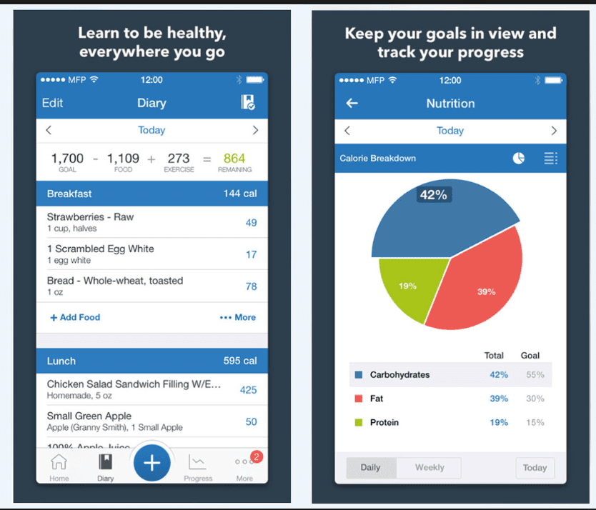
Nutrition Treatment Apps
My Fitness Pal

Slide 17
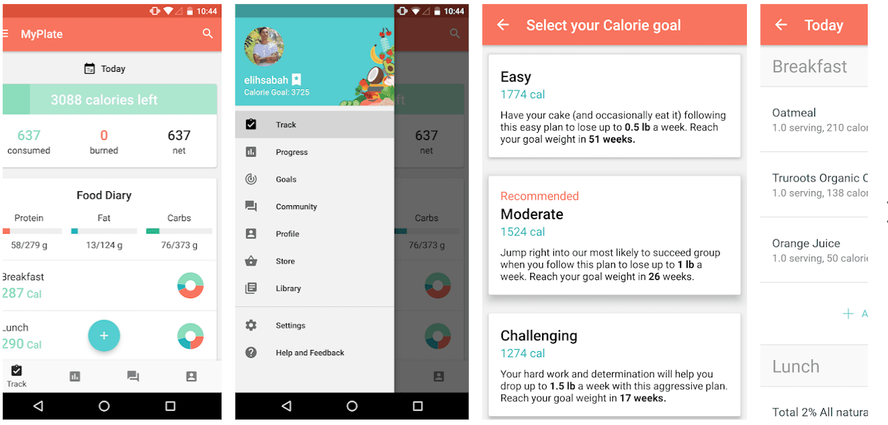
Nutrition Treatment Apps
My Plate

Slide 18
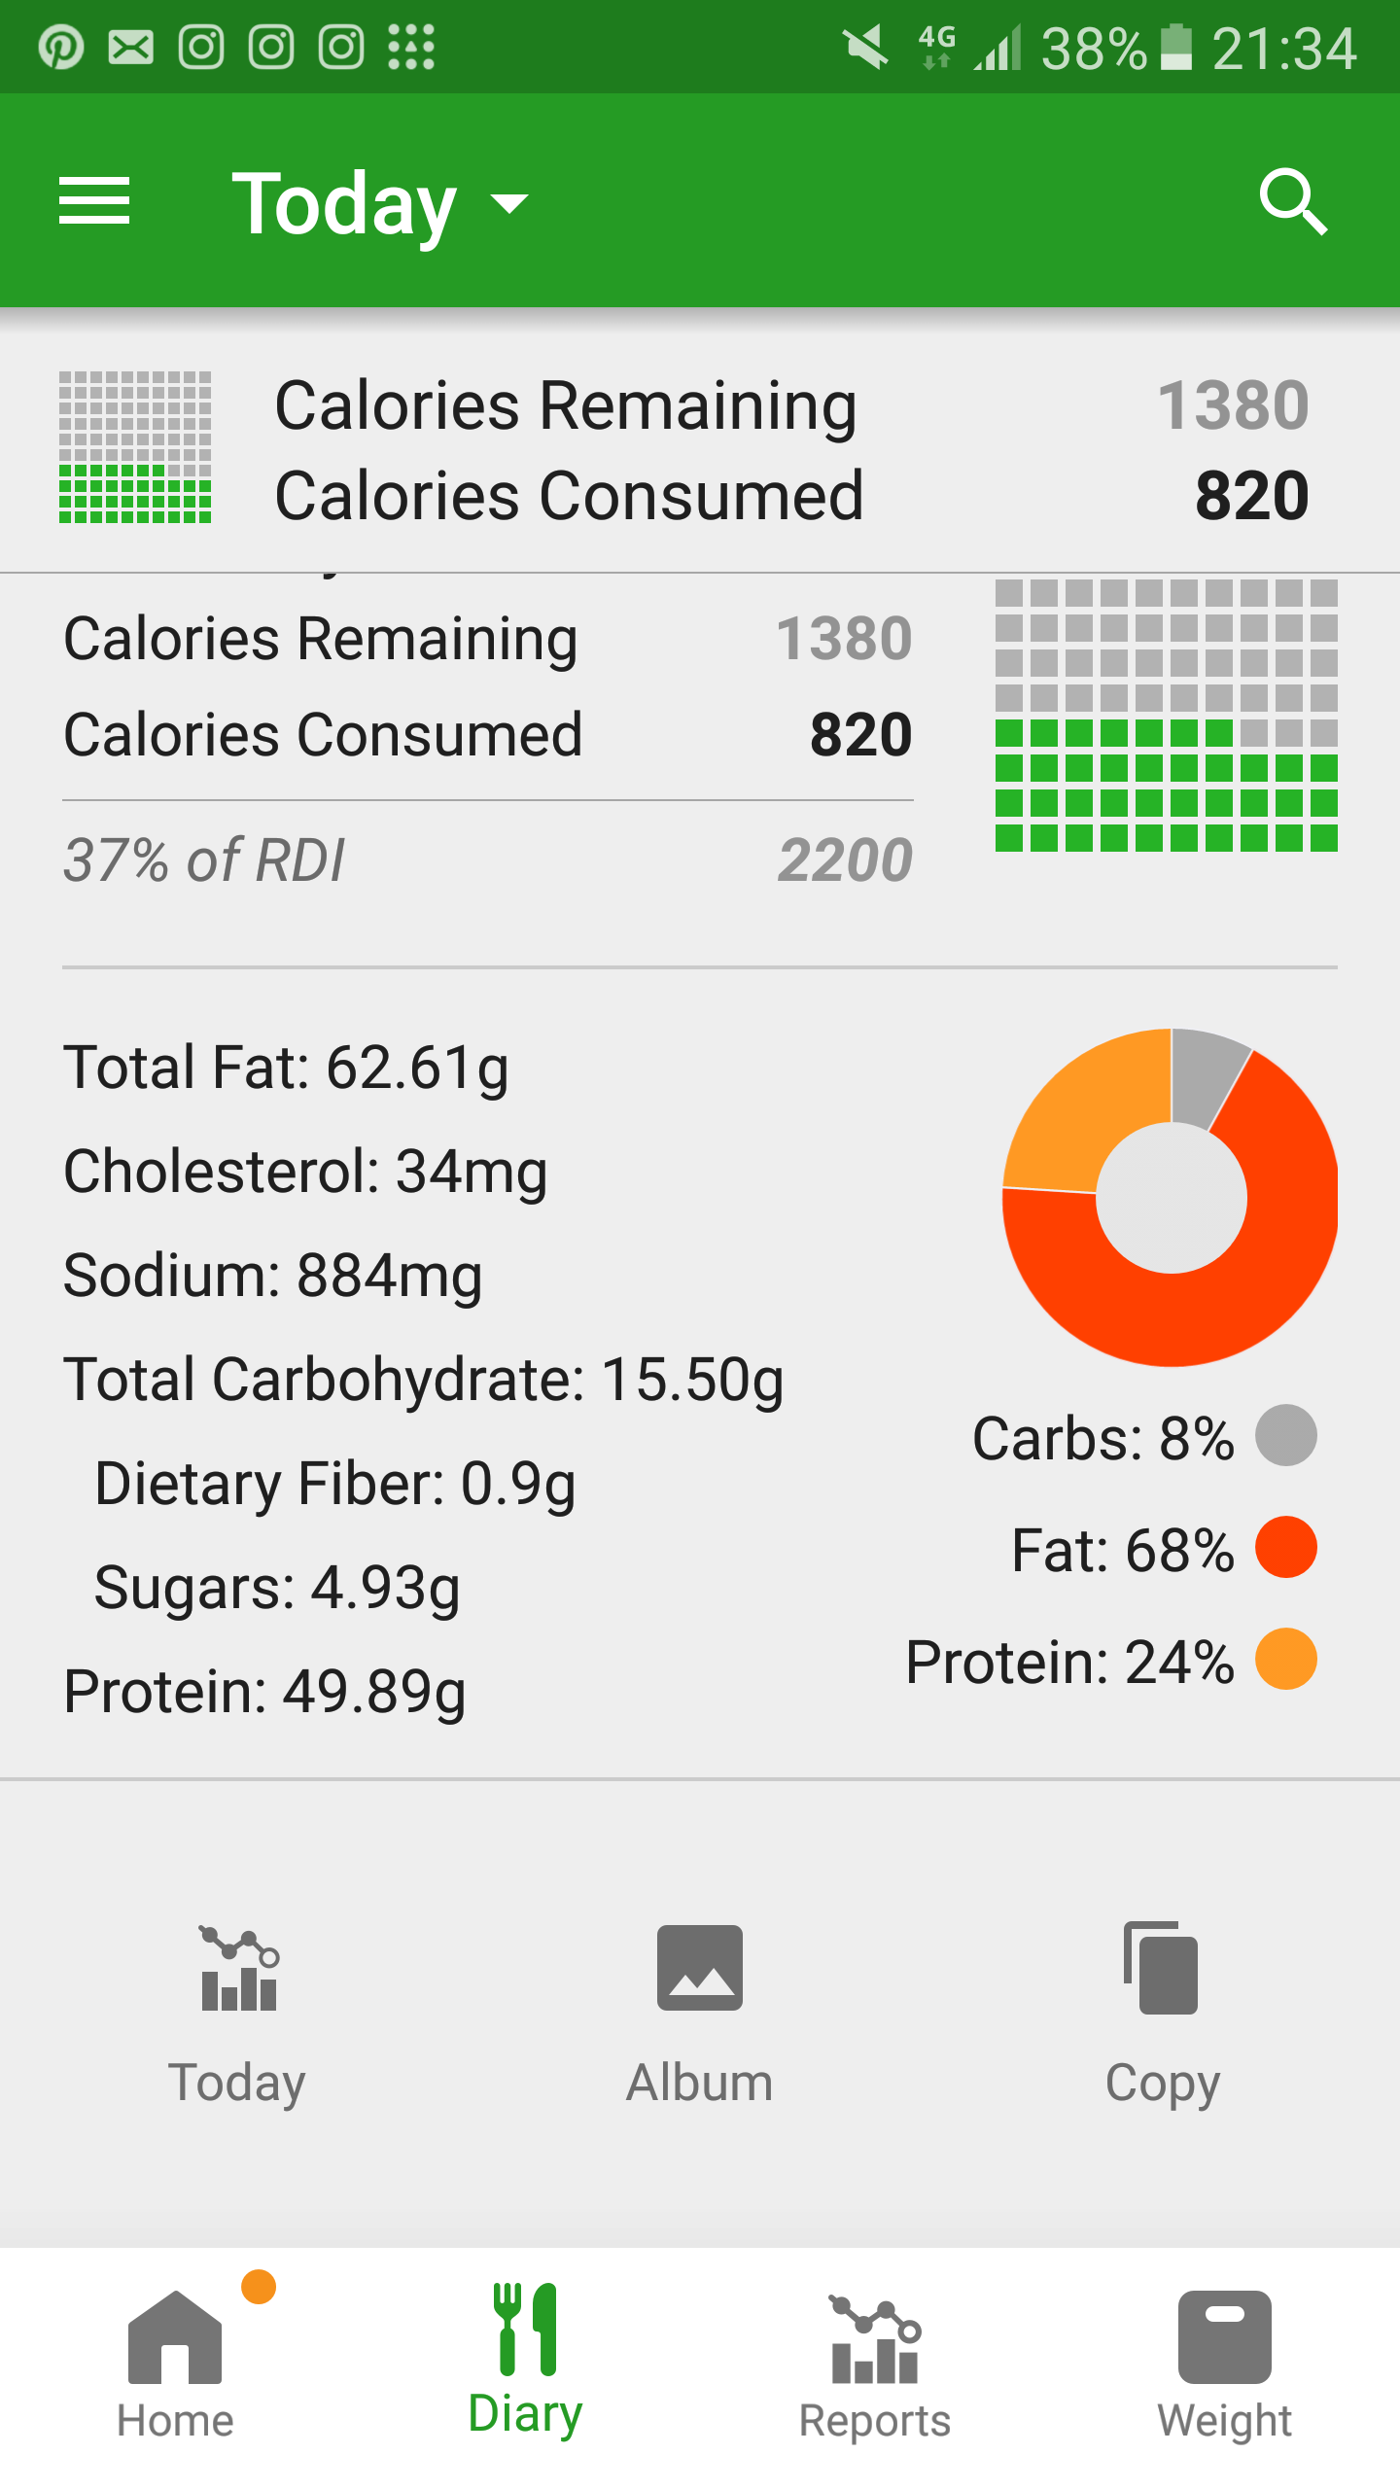
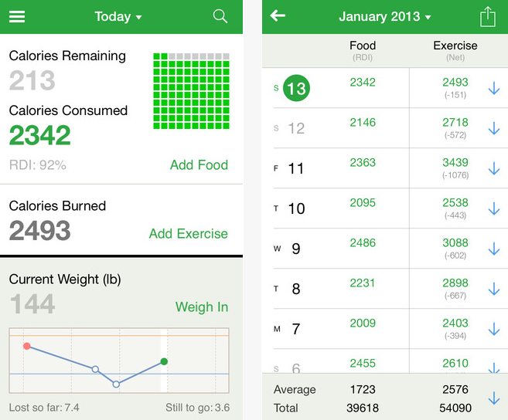
Nutrition Treatment Apps
Fat Secret

Slide 19
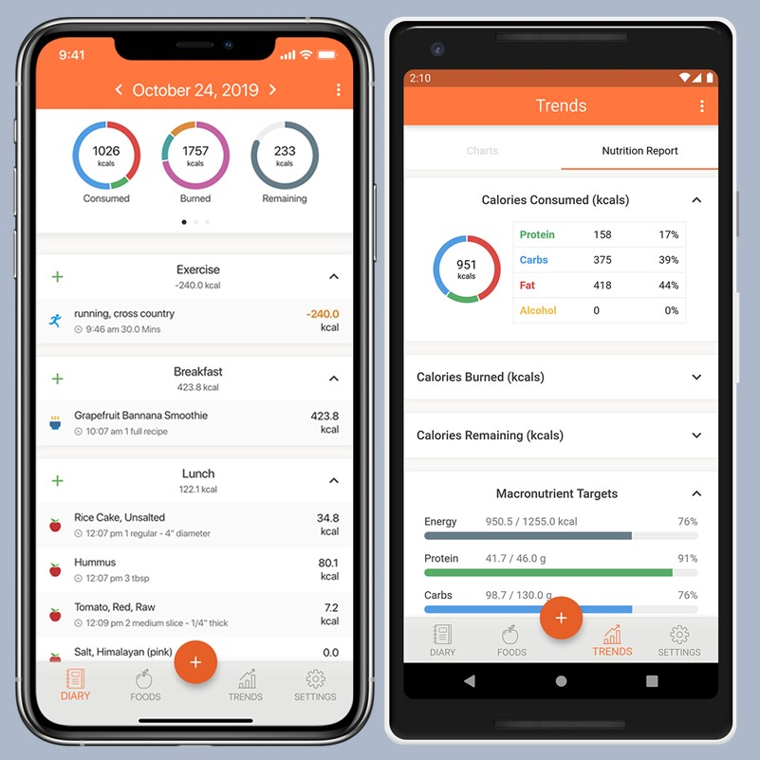
Nutrition Treatment Apps
Cronometer

Slide 20
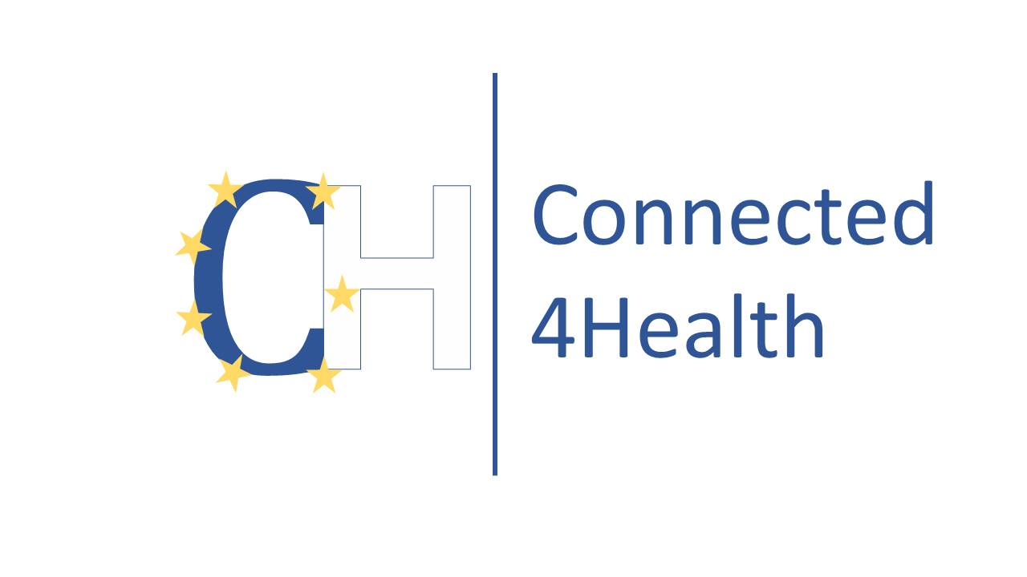
Instituto Politécnico de Bragança

