Slide 1
ASSESSMENT OF NUTRITIONAL STATUS Instituto Politécnico de Bragança
Connected 4 Health

Slide 2
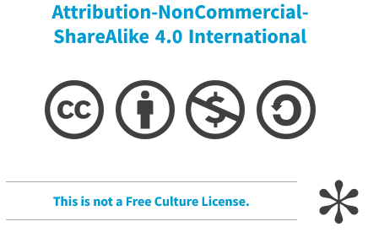
Project Number: 2021-1-RO01- KA220-HED-38B739A3
The European Commission's support for the production of this presentation does not constitute an endorsement of the contents, which reflect the views only of the authors, and the Commission cannot be held responsible for any use which may be made of the information contained therein.

Slide 3
Assessment of nutritional status
Involves methods and techniques to verify an individual’s nutrition status
Objective: identify potential concerns, aiding in the recovery and maintenance of health

Slide 4
Assessment of nutritional status
Is the result of the balance between nutrient intake and nutrient requirements

Slide 5
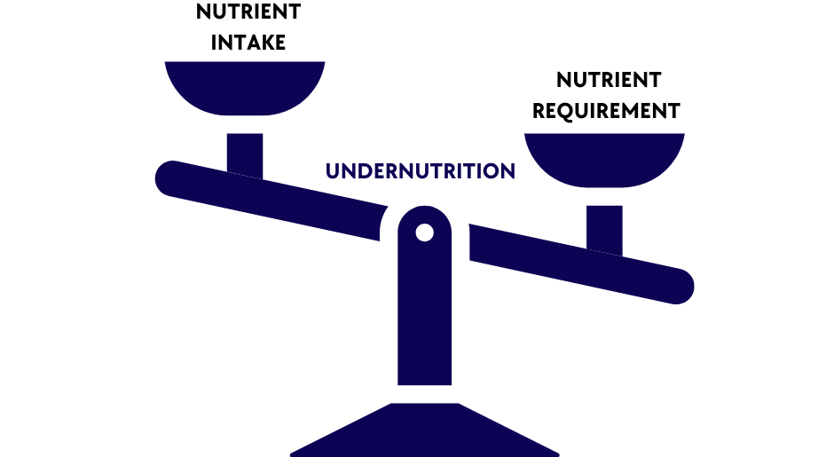
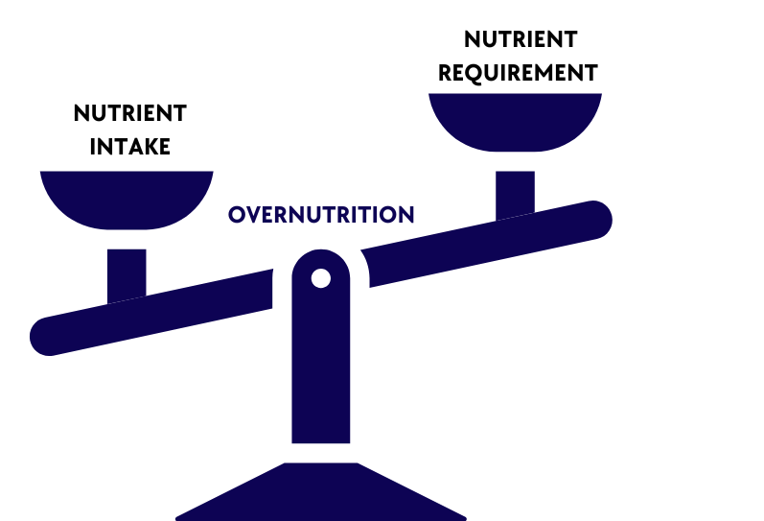
Assessment of nutritional status

Slide 6
ABCD Method
A: Anthropometric Assessment
B: Biochemical Assessment
C: Clinical Assessment
D: Dietary Assessment

Slide 7
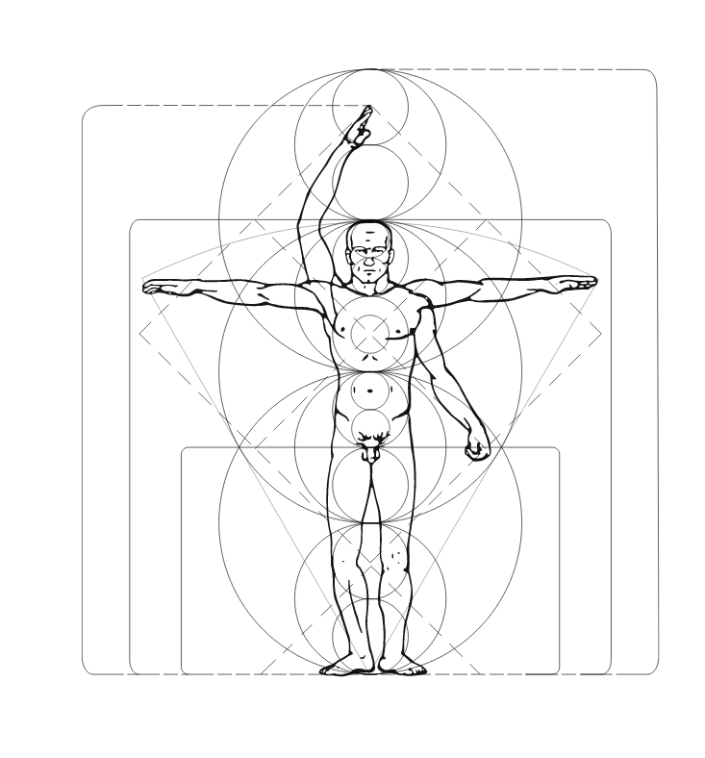
A - Anthropometric methods
Is the external measurement of the human body
Reflects health and nutritional status
Frequently are compared with standards or used in prediction equations

Slide 8
A - Anthropometric methods
BODY WEIGHT
Excess or deficit adversely influences morbidity and mortality

Slide 9
A - Anthropometric methods
HEIGHT
Is measured using a stand-alone stadiometer or one fixed at the appropriate height to a wall
Other anthropometric measurements can be taken and from these the height can be estimated:
Length of the ulna
Knee height
Demi-span

Slide 10
A - Anthropometric methods
Body Mass Index – BMI (Adults)
Is a weight for height indicator that may be used to classify overweight and obesity
Weight (Kg) / Height*Height (m2)
WEIGHT STATUS | BMI (Kg/m2)
Underweight | <18.5
Normal range | 18.5 – 24.9
Overweight | 25.0 – 29.9
Obese | >30
Obese Class I | 30.0 – 34.9
Obese Class II | 35.0 – 39.9
Obese Class III | >40.0

Slide 11
A - Anthropometric methods
A BMI above the recommended increases the risk of developing certain conditions, including type 2 diabetes, heart disease, osteoarthritis
A very low BMI increases the risk of osteoporosis and complications associated with malnutrition

Slide 12
A - Anthropometric methods
Example
Weight = 72 Kg, Height = 1.65m
BMI = 72 / (1.65*1.65) = 26.45 -> Overweight
Increased the risk of comorbidities

Slide 13
A - Anthropometric methods
Body Mass Index – BMI (Children)
For children and teens, BMI age and sex-specification percentiles are use

Slide 14
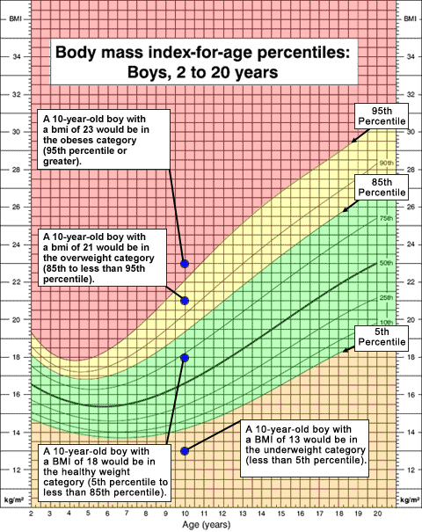
A - Anthropometric methods
WEIGHT STATUS | BMI LEVEL*
Underweight | < 5TH percentile
Normal weight | 5th - 84.9th percentile
Overweight | 85th – 94.9th percentile
Obese | >95th percentile
*Cutt-off point to children between 2 to 18 years old
https://www.who.int/tools/child-growth-standards/standards/weight-for-age

Slide 15
A - Anthropometric methods
WAIST CIRCUMFERENCES
 | MEN | WOMEN
Increase risk of metabolic complications | > 94 cm | > 80 cm
Substance increased risk of metabolic complication | >102 cm | > 88 cm

Slide 16
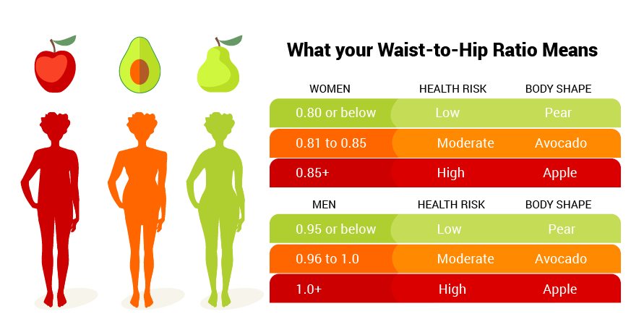
A - Anthropometric methods
WAIST TO HIP RATIO
Waist to hip ratio (WHR) is a useful indicator of obesity related health risks
https://www.nestle-caribbean.com/wellness-tools/waist-hip-ratio/about

Slide 17
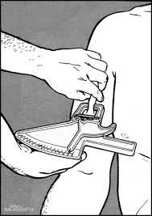
A - Anthropometric methods
SKINFOLD THICKNESS
The relationship between subcutaneous fat and total body fat can be explored by measuring the thickness of skinfolds at specific locations to estimate adiposity

Slide 18
A - Anthropometric methods
BIOELECTRICAL IMPEDANCE
Bioelectrical impedance analysis is an easy, non-invasive bedside measure used to estimate total body water and body composition

Slide 19
B - Biochemical Methods
Biochemical assessment means checking levels of nutrients in a person’s blood, urine, or stools.
Lab test results can give trained health professionals useful information about medical problems that may affect appetite or nutritional.

Slide 20
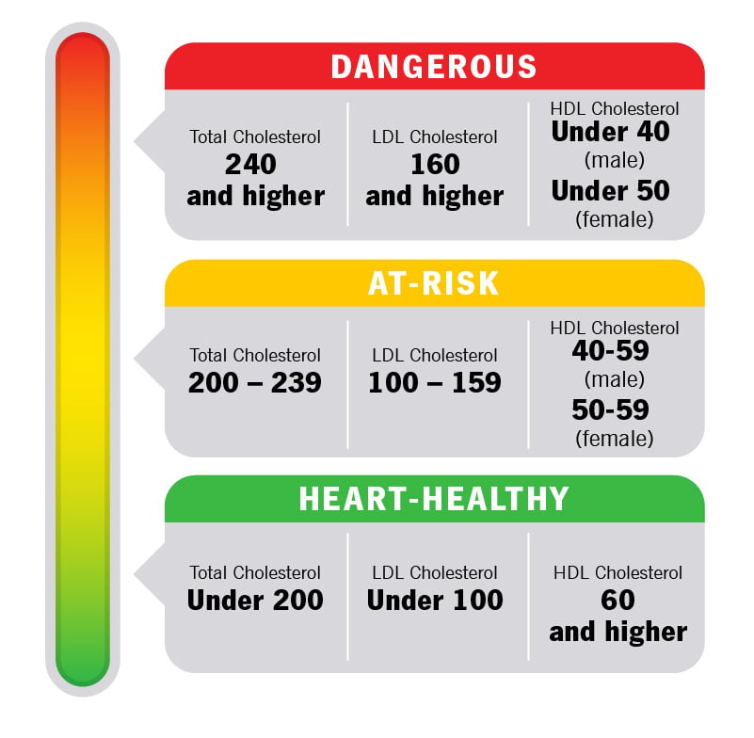
B - Biochemical Methods
Cholesterol
Evaluate the fat metabolism and to assess risk for cardiovascular diseases
https://my.clevelandclinic.org/health/articles/11920-cholesterol-numbers-what-do-they-mean

Slide 21
B - Biochemical Methods
Diabetes tests
https://www.cdc.gov/diabetes/pdfs/library/socialmedia/road-to-diabetes-infographic.pdf

Slide 22
C - Clinical Methods
Clinical assessment includes checking for visible signs of nutritional deficiencies
Hair, mouth, nails, skin, eyes, tongue, muscles, bones
Medical history; medications
Risk factors for disease (smoking, alcohol use, overweight)
Symptoms (fever, diarrhea, vomiting)

Slide 23
D - Dietary Assessment
Retrospective methods
24-hour recall (24 HR)
Dietary history
Food frequency questionnaire
Short frequency questionnaires

Slide 24
D - Dietary Assessment
Current methods
Weight food record
Food record with estimated weights
Duplicate analysis
Records using electronic equipment's (mobiles, phones, cameras)

Slide 25
D - Dietary Assessment
Compliance with the food based dietary guidelines
https://www.fao.org/nutrition/education/food-based-dietary-guidelines

Slide 26
Instituto Politécnico de Bragança

